Slide 1

Docker Foundation
An in depth introduction to Docker and Containers

Slide 2
Docker Images
Docker Images
Registries and Docker Hub
Dockerfiles 1
Dockerfiles 2

Slide 3
1: Docker Images

Slide 4
Objectives
Describe Docker image layering
Understand the nature of the Docker layered file system implementation
Gain familiarity with the Docker directory structure
Move images between registries and the local Docker Host
Explore image creation

Slide 5
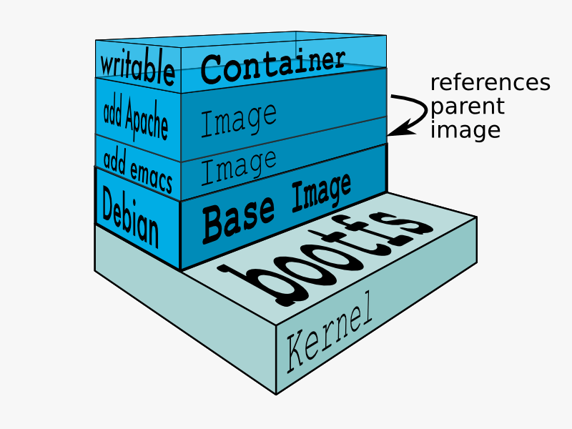
Docker Images
Docker containers are constructed by sequentially applying meta data and file system layers from one or more images
A Docker image includes metadata and an optional file system layer
Image meta data includes the ID of the image’s parent, the default command to run, etc.
In Docker Engine <= v1.9 image IDs were random (UUIDs)
In Docker Engine >= v1.10 image IDs are SHA256 hashes of the image (content addressable)
Layered images tend to supply one specific feature on top of the parent image
Upper layer metadata and files mask metadata and files at lower layers with the same name/pathname
An image with no parent image is called a Base Image
Base images tend to be largish and house operating system libraries and executables (e.g. Debian, Ubuntu, Centos, etc.)
Image metadata and files are immutable
Allows one Image to support multiple Container instances with repeatable results
Reduces the disk and memory footprint of a given set of containers which share the same read only images
Containers have a writable file system layer
The container file system layer is initially empty
All writes go to this file system layer and overlay any matching underlying image files
In this way, container file systems contain only the delta between their file system state and that of their underlying images
The view from the top down, including all file system layers in the stack, is called the union file system

Slide 6
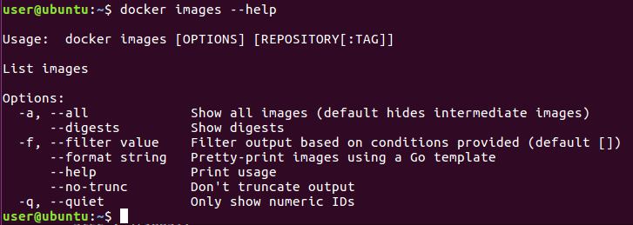
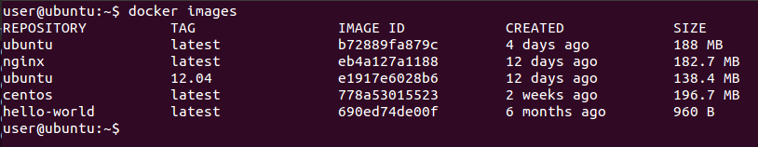
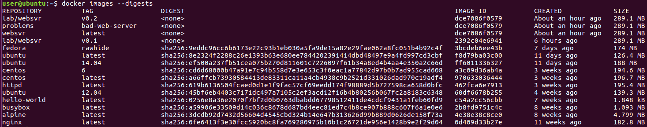
Displaying images
The docker images command displays the images available on the docker engine
Images that use the v2 format have a SHA 256 digest and ID, both of which identify the content
The ID is the hash of the image manifest and the uncompressed filesystem layers
The digest is the hash of the image manifest and the gzipped filesystem layers
Useful for download verification
docker pull, create, run, and rmi can use the digest
docker pull hello-world@sha256:0256e8a36e2070f7bf2d0b0763dbabdd67798512411de4cdcf9431a1feb60fd9
Images not pulled will not have a digest
https://docs.docker.com/engine/userguide/storagedriver/imagesandcontainers/#/content-addressable-storage

Slide 7
Image Inspect
user@ubuntu:~$ docker inspect alpine
[ { "Id": "sha256:4e38e38c8ce0b8d9041a9c4fefe786631d1416225e13b0bfe8cfa2321aec4bba",
"RepoTags": [ "alpine:latest“ ],
"RepoDigests": [ "alpine@sha256:3dcdb92d7432d56604d4545cbd324b14e647b313626d99b889d0626de158f73a" ],
"Parent": "",
"Comment": "",
"Created": "2016-06-23T19:55:18.048565927Z",
"Container": "4c573a7cf4a3e50eee83db0405523923591b9c3e94715e1f7f9b9fc8f39fbd4d",
"ContainerConfig": {
"Hostname": "4c573a7cf4a3",
"Domainname": "",
"User": "",
"AttachStdin": false,
"AttachStdout": false,
"AttachStderr": false,
"Tty": false,
"OpenStdin": false,
"StdinOnce": false,
"Env": [ "PATH=/usr/local/sbin:/usr/local/bin:/usr/sbin:/usr/bin:/sbin:/bin" ],
"Cmd": [
"/bin/sh",
"-c",
"#(nop) ADD file:852e9d0cb9d906535af512a89339fc70b2873a0f94defbcbe41cd44942dd6ac8 in /"
],
"Image": "",
"Volumes": null,
"WorkingDir": "",
"Entrypoint": null,
"OnBuild": null,
"Labels": null
},
"DockerVersion": "1.10.3",
"Author": "",
"Config": {
"Hostname": "4c573a7cf4a3",
"Domainname": "",
"User": "",
"AttachStdin": false,
"AttachStdout": false,
"AttachStderr": false,
"Tty": false,
"OpenStdin": false,
"StdinOnce": false,
"Env": [ "PATH=/usr/local/sbin:/usr/local/bin:/usr/sbin:/usr/bin:/sbin:/bin" ],
"Cmd": null,
"Image": "",
"Volumes": null,
"WorkingDir": "",
"Entrypoint": null,
"OnBuild": null,
"Labels": null
},
"Architecture": "amd64",
"Os": "linux",
"Size": 4798851,
"VirtualSize": 4798851,
"GraphDriver": { "Name": "aufs", "Data": null },
"RootFS": {
"Type": "layers",
"Layers": [ "sha256:4fe15f8d0ae69e169824f25f1d4da3015a48feeeeebb265cd2e328e15c6a869f" ]
}
} ]
The docker inspect subcommand displays the meta data associated with an image
All image configuration and/or descriptive data which is not part of the image’s filesystem can be found in the metadata produced by inspect
docker inspect displays metadata for:
Images
Containers
Networks
Volumes
Etc.

Slide 8
Top Level Metadata Keys
Id – image ID [hash]
RepoTags – locally defined repository:tag names for the image
RepoDigests – repository hash (entire repo)
Parent – parent image ID
Comment – commit message
Created – timestamp of the image’s creation
Container – container ID used to commit image
ContainerConfig – metadata from container used to create this image
DockerVersion – docker version used to build the image
Author – person or organization responsible for the image
Config – metadata for containers generated from this image
Architecture – image system architecture
Os – image operating system
Size – total size of the image including all layers it is composed of
VirtualSize – same as size (this field is deprecated)
GraphDriver – unioning filesystem driver used
RootFS – list of layers used by the image

Slide 9
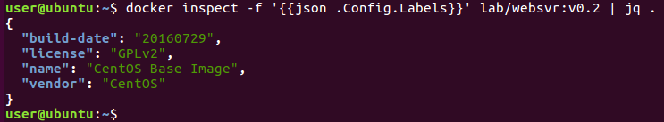
Particularly useful metadata
//IDENTITY
user@ubuntu:~$ docker inspect -f '{{.Id}}' lab/websvr:v0.2
sha256:dce7086f0579209099b9e686eeeeaf52449ec82ddbeffee1b7fcc05071848d37
user@ubuntu:~$ docker inspect -f '{{.RepoTags}}' lab/websvr:v0.2
[lab/websvr:v0.2 problems:bad-web-server websvr:latest]
user@ubuntu:~$ docker inspect -f '{{.Parent}}' lab/websvr:v0.2
sha256:2392c04e694138e499490491efccae406a2fea5e487c47498ada2ef281d7f136
user@ubuntu:~$ docker inspect -f '{{.Size}}' httpd
195428379
//CONFIG (applied to containers)
user@ubuntu:~$ docker inspect -f '{{.Config.ExposedPorts}}' httpd
map[80/tcp:{}]
user@ubuntu:~$ docker inspect -f '{{.Config.Env}}' httpd
[ PATH=/usr/local/apache2/bin:/usr/local/sbin:/usr/local/bin:/usr/sbin:/usr/bin:/sbin:/bin
HTTPD_PREFIX=/usr/local/apache2 HTTPD_VERSION=2.4.23
HTTPD_SHA1=5101be34ac4a509b245adb70a56690a84fcc4e7f
HTTPD_BZ2_URL=https://www.apache.org/dist/httpd/httpd-2.4.23.tar.bz2 ]
user@ubuntu:~$ docker inspect -f '{{.Config.Cmd}}' httpd
[httpd-foreground]
user@ubuntu:~$ docker inspect -f '{{.Config.WorkingDir}}' httpd
/usr/local/apache2
Go Template Documentation
https://golang.org/pkg/text/template/

Slide 10
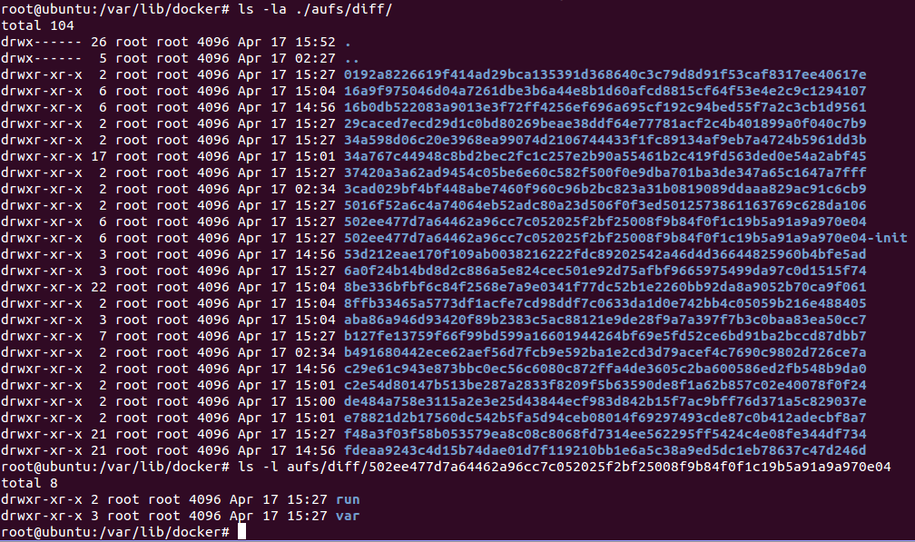
The images directory (v1.10+)
Image file system layers are stored in the Docker Engine’s working directory
In our Ubuntu lab system: /var/lib/docker/aufs
Image metadata map layer SHA hashes to cache-ids which point to the local layer cache
In our Ubuntu system: /var/lib/docker/aufs/diff
Diffs include the files and directories that make up the layer in question
user@ubuntu:~$ sudo su -
root@ubuntu:~# cd /var/lib/docker
root@ubuntu:/var/lib/docker# docker ps
CONTAINER ID IMAGE COMMAND CREATED STATUS PORTS NAMES
9c0539b42b4c nginx "nginx -g 'daemon off" About an hour ago Up About an hour 80/tcp, 443/tcp stoic_ardinghelli
root@ubuntu:/var/lib/docker# ls -l image/aufs/layerdb/mounts/9c0539b42b4cdd44a3d5b7ab3c969b218d4de165279e44015ecab6e0c7fdc245/
total 12
-rw-r--r-- 1 root root 69 Apr 17 15:27 init-id
-rw-r--r-- 1 root root 64 Apr 17 15:27 mount-id
-rw-r--r-- 1 root root 71 Apr 17 15:27 parent
root@ubuntu:/var/lib/docker# cat image/aufs/layerdb/mounts/9c0539b42b4cdd44a3d5b7ab3c969b218d4de165279e44015ecab6e0c7fdc245/mount-id
502ee477d7a64462a96cc7c052025f2bf25008f9b84f0f1c19b5a91a9a970e04
root@ubuntu:/var/lib/docker# cat image/aufs/layerdb/mounts/9c0539b42b4cdd44a3d5b7ab3c969b218d4de165279e44015ecab6e0c7fdc245/init-id
502ee477d7a64462a96cc7c052025f2bf25008f9b84f0f1c19b5a91a9a970e04-init
root@ubuntu:/var/lib/docker# cat image/aufs/layerdb/mounts/9c0539b42b4cdd44a3d5b7ab3c969b218d4de165279e44015ecab6e0c7fdc245/parent
sha256:400844ac32a0beb2184bb766eb6d922cf0e55a87e9b89017a7d7c8a0677c17bd
root@ubuntu:/var/lib/docker# ls -l image/aufs/layerdb/sha256/400844ac32a0beb2184bb766eb6d922cf0e55a87e9b89017a7d7c8a0677c17bd
total 20
-rw-r--r-- 1 root root 64 Apr 17 15:27 cache-id
-rw-r--r-- 1 root root 71 Apr 17 15:27 diff
-rw-r--r-- 1 root root 71 Apr 17 15:27 parent
-rw-r--r-- 1 root root 1 Apr 17 15:27 size
-rw-r--r-- 1 root root 82 Apr 17 15:27 tar-split.json.gz
root@ubuntu:/var/lib/docker# cat image/aufs/layerdb/sha256/400844ac32a0beb2184bb766eb6d922cf0e55a87e9b89017a7d7c8a0677c17bd/cache-id
37420a3a62ad9454c05be6e60c582f500f0e9dba701ba3de347a65c1647a7fff
root@ubuntu:/var/lib/docker# cat image/aufs/layerdb/sha256/400844ac32a0beb2184bb766eb6d922cf0e55a87e9b89017a7d7c8a0677c17bd/parent
sha256:312751f456c3a5927bb8762459eb1488f8d31dd9dc1299df82e7de0da5cfe48b
root@ubuntu:/var/lib/docker# ls -l image/aufs/layerdb/sha256/312751f456c3a5927bb8762459eb1488f8d31dd9dc1299df82e7de0da5cfe48b
total 20
-rw-r--r-- 1 root root 64 Apr 17 15:27 cache-id
-rw-r--r-- 1 root root 71 Apr 17 15:27 diff
-rw-r--r-- 1 root root 71 Apr 17 15:27 parent
-rw-r--r-- 1 root root 1 Apr 17 15:27 size
-rw-r--r-- 1 root root 82 Apr 17 15:27 tar-split.json.gz
Mount layer: the writable container layer
Init layer: container setup added by docker
Parent layer: the image parent layer
Cache-id: Images reference their filesystem layers via cache-id

Slide 11
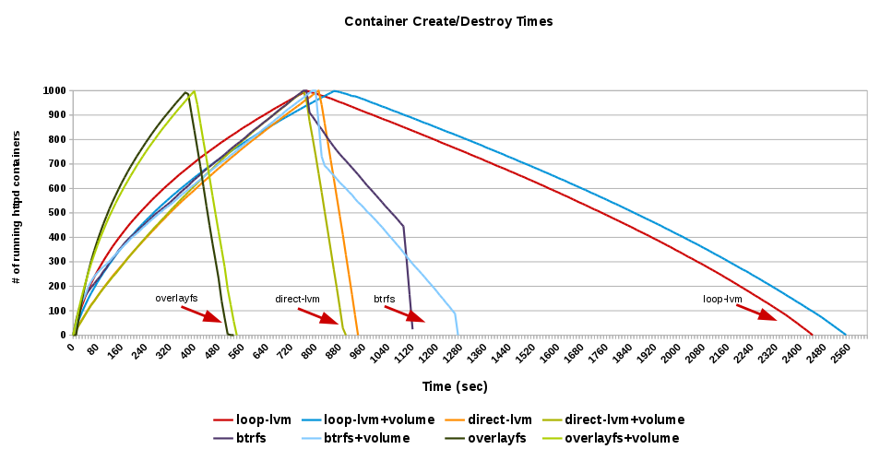
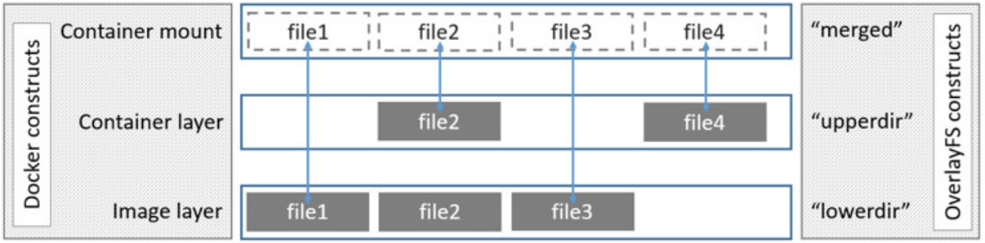
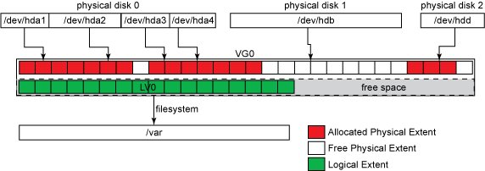
Filesystem Backends
Docker depends on the efficient use of layered images
Various file system features in the kernel implement file system layering
Each container has two layers
The init layer, whose parent is the container’s specified image (RO operational data)
Contains /etc/hosts, /etc/hostname and /etc/resolv.conf as well as the Docker configured /dev directory
A child of init which contains normal container content (RW application data)
Committing a container creates a new image based on the container layer with the original image as the parent
Docker filesystem backends (listed in Docker preference order):
OverlayFS - implements union mount for other FS
Introduced in kernel 3.18
Very fast, designed for SSDs and hybrids
aufs – “Advanced multi layered Unification FileSystem” stores layers as directories with aufs metadata
FILE level scheme with shared storage
Default Ubuntu but not widely supported on RHEL
Originally limited to 42 layers, now 127 (the 127 limit applies to all drivers as of Docker 0.7.2)
btrfs – uses file system level snapshotting
BLOCK level scheme with shared storage
/var/lib/docker must be on a btrfs file system, layers stored as sub-volumes in /var/lib/docker/btrfs/subvolumes
Default on SUSE
devicemapper - uses device-mapper thin provisioning module (dm-thinp) to implement layers
Default on RHEL systems
BLOCK level scheme with shared storage
Device-mapper is the kernel part of the LVM2 system
vfs – universally supported but slow and inefficient
FILE level scheme with no shared storage
Each layer is a separate directory with a deep copy of its parent (no COW)
Container Independent Volumes
Write-heavy I/O (databases, logs, etc.) may be done to a normal host volume eliminating unnecessary storage backend overhead
Host volumes can be accessed across multiple concurrent containers
Like a SAN without the network overhead
Create 1000 Apache containers, then destroy them
Standalone
With Host Volume attached
loop-lvm adds a file system loop device over dm-thinp, performance is similar to aufs

Slide 12
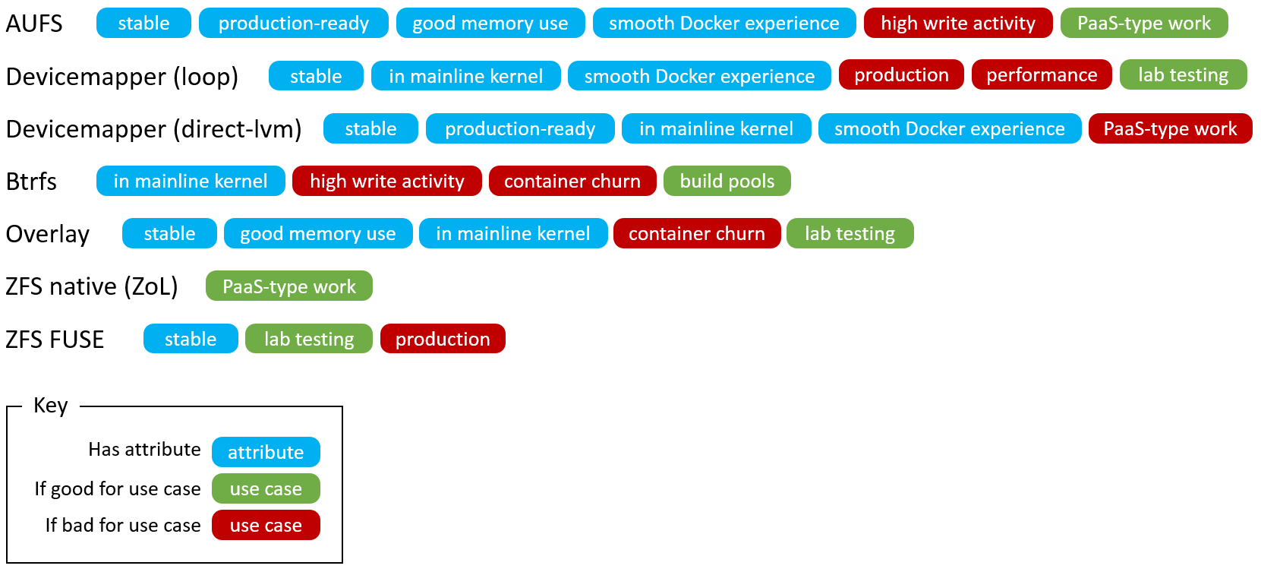
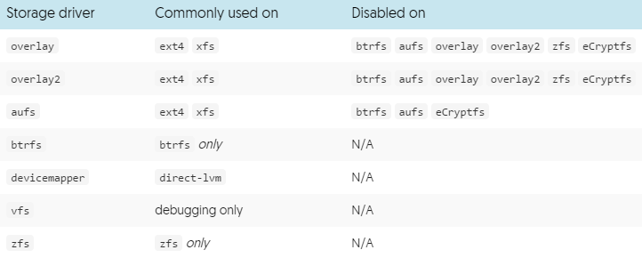
Driver Stability
Many consider OverlayFS 1 & 2 the future of Docker storage
Yet it is less mature and less stable than aufs and devicemapper
Use OverlayFS with caution and expect to encounter more bugs and nuances than if you were using a more mature driver

Slide 13
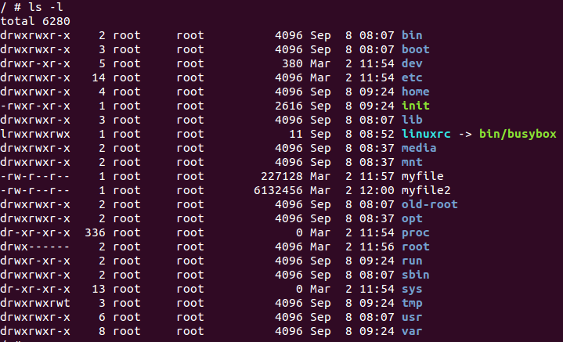
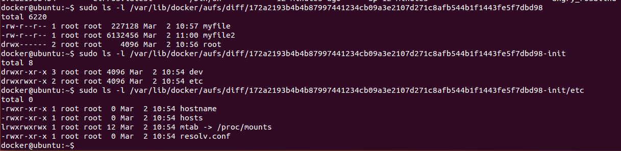
Container deltas
/var/lib/docker/aufs/diff
Holds AUFS copy on write (COW) data
Files from any other layer which have been modified
e.g. /etc/hostname
Holds new files
Specific to the container
e.g. /myfile & myfile2
Container
Host

Slide 14
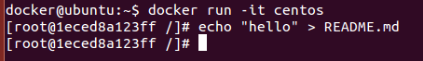
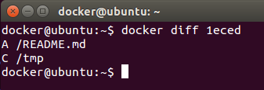
docker diff
The docker diff command can be used to view the changes in the container’s filesystem layer
Works regardless of filesystem Unioning driver
Three types of deltas are recorded
A - Add
D - Delete
C - Change

Slide 15
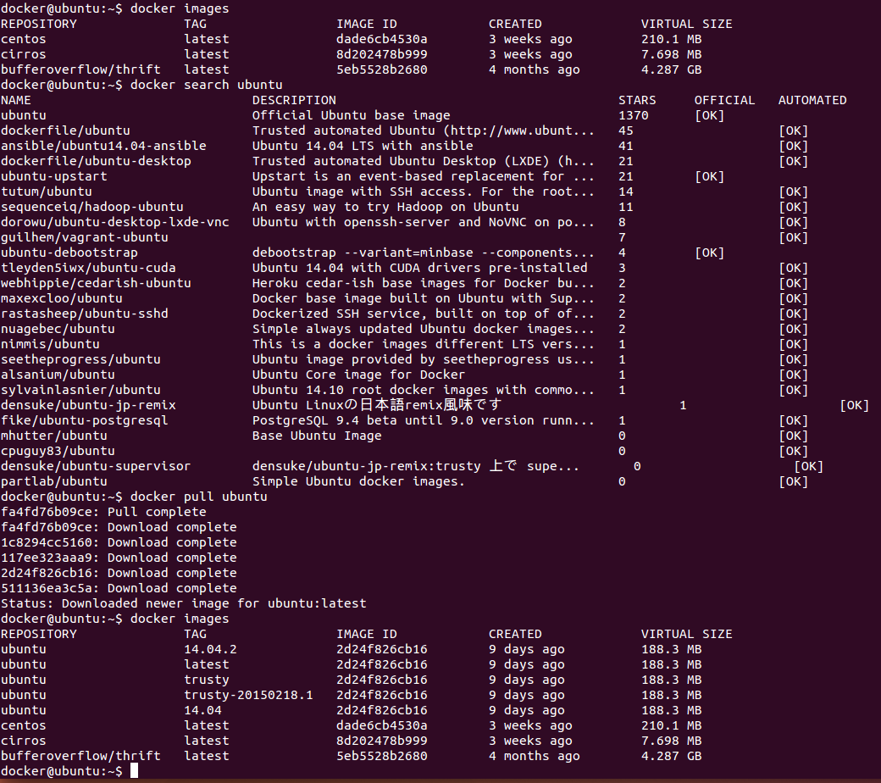
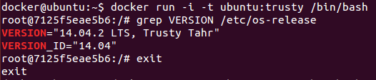
Image Tags
Images are given tag names for easy reference
One image may have several tags
One repository may contain several images
You can specify a particular image within a repository using a trailing : and the tag name
e.g. “ubuntu:14.04”
If no image tag is supplied, Docker assumes the “latest” tag

Slide 16
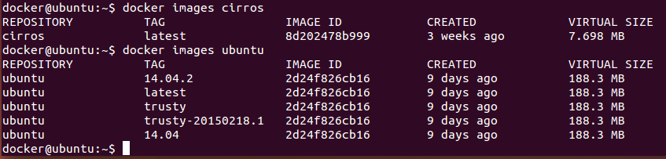
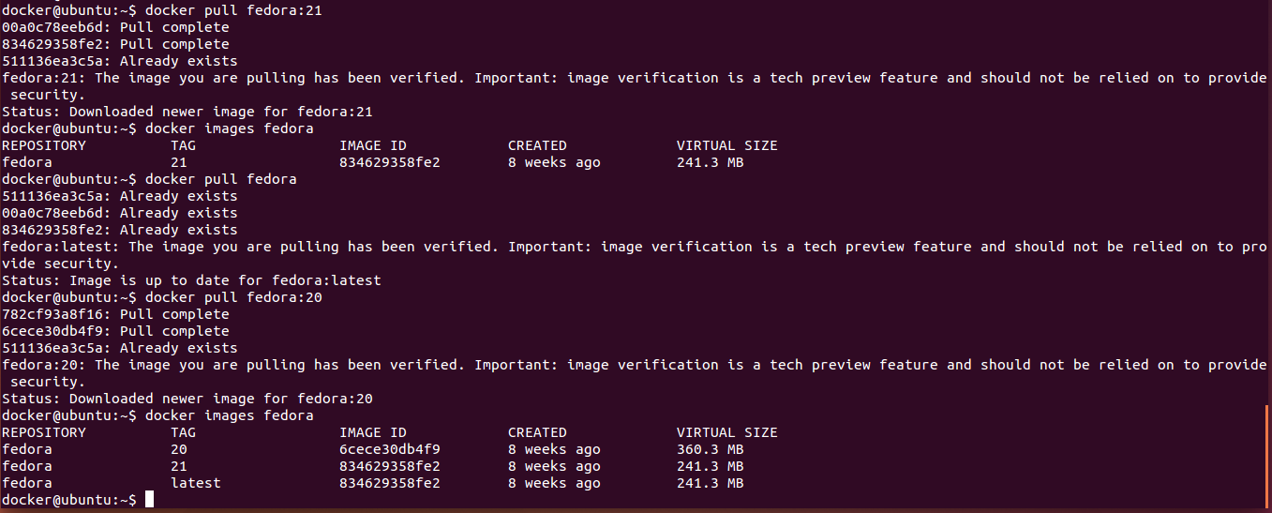
Displaying Repositories
You can scope the images sub command to examine a particular repository
You can also specify a particular tagged image to pull
Required when you want to pull something other than the latest tag
Default is “latest”
Can be used to pull a newer version of the image from a registry

Slide 17
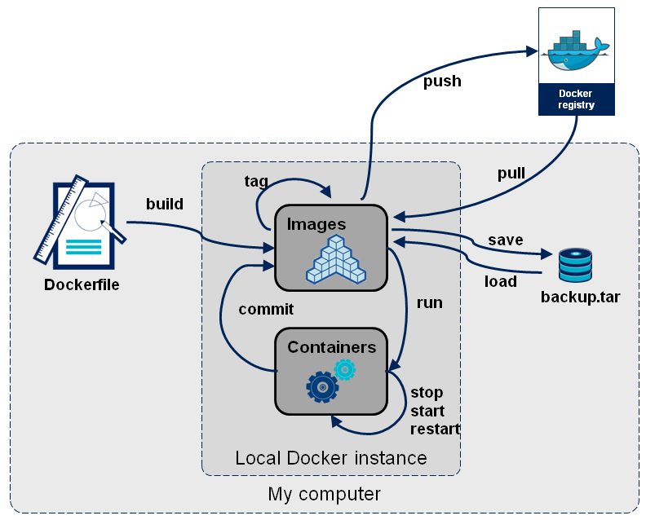
Creating Images
Docker images are the basis of containers
Docker stores downloaded images on the Docker host
If a required image isn't already present on the host it is downloaded from a registry
There are two ways to create new images
Update a container created from an image and commit the results to a new image
Use a Dockerfile to specify instructions to create an image

Slide 18
Committing a Container
Committing an existing Container is a simple way to create a new Docker image
Create a container with the desired base
Make the changes necessary to the container layer
Commit the container layer as a new image
docker@ubuntu:~$ docker run -t -i ubuntu:14.04 /bin/bash
root@3802a4a2a2e9:/# apt-get install git
...
root@3802a4a2a2e9:/# git clone http://github.com/apache/thrift
…
root@3802a4a2a2e9:/# cd thrift
root@3802a4a2a2e9:/thrift# git checkout 0.9.1
...
root@3802a4a2a2e9:/thrift# exit
exit
docker@ubuntu:~$ docker commit -m "Thrift dev" -a "Sam Thrift" 3802a4a2a2e9 user_sam/thriftdev:0.9.1
ca0310547ecb9e71370479f94b5977a358054210d74c06bc0f869e32d51e96ae
docker@ubuntu:~$ docker images
REPOSITORY TAG IMAGE ID CREATED VIRTUAL SIZE
user_sam/thriftdev 0.9.1 ca0310547ecb 8 seconds ago 247.7 MB
ubuntu 14.04.2 2d24f826cb16 13 days ago 188.3 MB
ubuntu 14.04 2d24f826cb16 13 days ago 188.3 MB
ubuntu latest 2d24f826cb16 13 days ago 188.3 MB
ubuntu trusty 2d24f826cb16 13 days ago 188.3 MB
ubuntu trusty-20150218.1 2d24f826cb16 13 days ago 188.3 MB
ubuntu 12.04 1f80e9ca2ac3 13 days ago 131.5 MB
ubuntu 12.04.5 1f80e9ca2ac3 13 days ago 131.5 MB
ubuntu precise 1f80e9ca2ac3 13 days ago 131.5 MB
ubuntu precise-20150212 1f80e9ca2ac3 13 days ago 131.5 MB
centos latest dade6cb4530a 4 weeks ago 210.1 MB
cirros latest 8d202478b999 4 weeks ago 7.698 MB
fedora 20 6cece30db4f9 9 weeks ago 360.3 MB
fedora 21 834629358fe2 9 weeks ago 241.3 MB
fedora latest 834629358fe2 9 weeks ago 241.3 MB
bufferoverflow/thrift latest 5eb5528b2680 4 months ago 4.287 GB

Slide 19
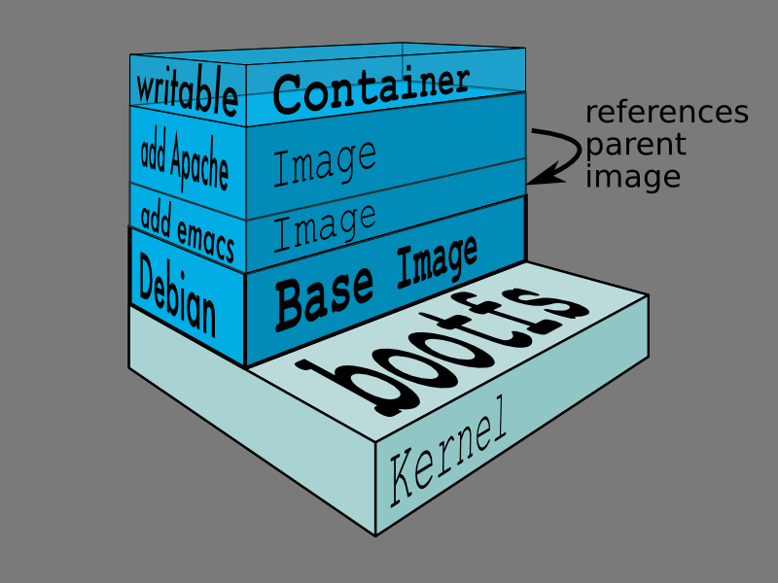
Examining Ancestry
Each Docker container has a parent image
Each Docker image has a parent image, with the exception of base images
Intermediate layer images have no repository name and no tag name
Intermediate images can be used to collect common files beneath multiple named images
Intermediate images are not designed to be directly used by containers (but can be)
docker@ubuntu:~$ docker run -t -i user_sam/thriftdev:0.9.1 /bin/bash
root@8d75247087b5:/# cd thrift
root@8d75247087b5:/thrift# vi README
root@8d75247087b5:/thrift# exit
exit
docker@ubuntu:~$ docker commit -m "README update" -a "Sam Thrift" 8d75247087b5 user_sam/thriftdev:0.9.1_rm
fc056a4320ce0c439e240b7d56f991cdbd76a4fbc732c180bea4201a7d283cf4
docker@ubuntu:~$ docker images
REPOSITORY TAG IMAGE ID CREATED VIRTUAL SIZE
user_sam/thriftdev 0.9.1_rm fc056a4320ce 4 seconds ago 247.7 MB
user_sam/thriftdev 0.9.1 ca0310547ecb 11 minutes ago 247.7 MB
ubuntu 14.04.2 2d24f826cb16 13 days ago 188.3 MB
ubuntu latest 2d24f826cb16 13 days ago 188.3 MB
ubuntu trusty 2d24f826cb16 13 days ago 188.3 MB
ubuntu trusty-20150218.1 2d24f826cb16 13 days ago 188.3 MB
ubuntu 14.04 2d24f826cb16 13 days ago 188.3 MB
ubuntu precise 1f80e9ca2ac3 13 days ago 131.5 MB
ubuntu precise-20150212 1f80e9ca2ac3 13 days ago 131.5 MB
ubuntu 12.04.5 1f80e9ca2ac3 13 days ago 131.5 MB
ubuntu 12.04 1f80e9ca2ac3 13 days ago 131.5 MB
centos latest dade6cb4530a 4 weeks ago 210.1 MB
cirros latest 8d202478b999 4 weeks ago 7.698 MB
fedora 20 6cece30db4f9 9 weeks ago 360.3 MB
fedora 21 834629358fe2 9 weeks ago 241.3 MB
fedora latest 834629358fe2 9 weeks ago 241.3 MB
bufferoverflow/thrift latest 5eb5528b2680 4 months ago 4.287 GB
docker@ubuntu:~$ docker inspect -f='{{.Parent}}' user_sam/thriftdev:0.9.1_rm
ca0310547ecb9e71370479f94b5977a358054210d74c06bc0f869e32d51e96ae
docker@ubuntu:~$ docker inspect -f='{{.Parent}}' user_sam/thriftdev:0.9.1
2d24f826cb16146e2016ff349a8a33ed5830f3b938d45c0f82943f4ab8c097e7
docker@ubuntu:~$ docker inspect -f='{{.Parent}}' ubuntu:14.04
117ee323aaa9d1b136ea55e4421f4ce413dfc6c0cc6b2186dea6c88d93e1ad7c
docker@ubuntu:~$ sudo docker inspect -f='{{.Parent}}' 117ee323aaa9
1c8294cc516082dfbb731f062806b76b82679ce38864dd87635f08869c993e45
docker@ubuntu:~$ sudo docker inspect -f='{{.Parent}}' 1c8294cc5160
fa4fd76b09ce9b87bfdc96515f9a5dd5121c01cc996cf5379050d8e13d4a864b
docker@ubuntu:~$ sudo docker inspect -f='{{.Parent}}' fa4fd76b09ce
511136ea3c5a64f264b78b5433614aec563103b4d4702f3ba7d4d2698e22c158
docker@ubuntu:~$ sudo docker inspect -f='{{.Parent}}' 511136ea3c5a
docker@ubuntu:~$
user_sam/thriftdev:0.9.1_rm
user_sam/thriftdev:0.9.1
ubuntu:14.04
Lower layers

Slide 20
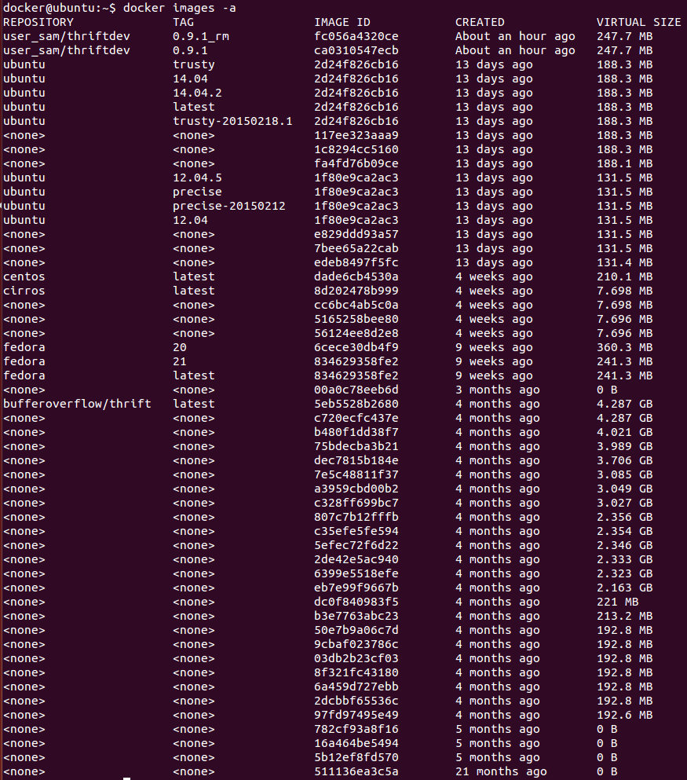
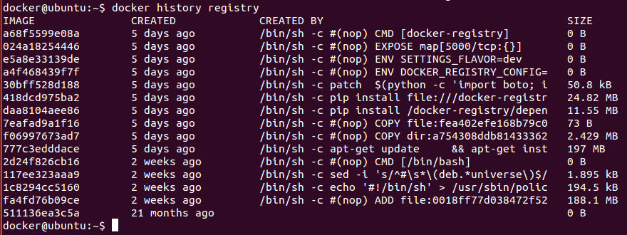
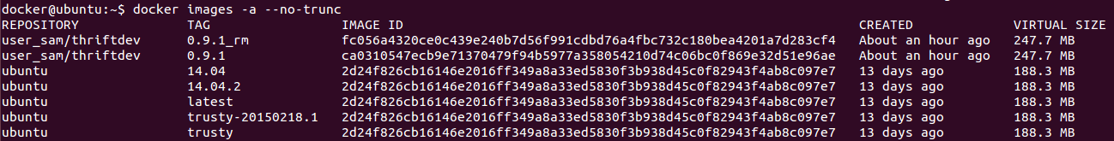
Intermediate Images
By default the “docker images” command does not display intermediate images
Intermediate images have no tag
Intermediate images act as building blocks for higher layer images
$ docker images -a
To display intermediate images
$ docker history displays an image’s parents
The --no-trunc switch can be used to display full IDs with most docker commands

Slide 21
Removing Images
Images can be deleted using the docker rmi command
The image must not be in use by any running or stopped containers
Images can be deleted by either
repository:tag
This deletes the tag and then only deletes the image if there are no other references
ID
You can only delete images by ID is they have 0 or 1 tags
Images are not removed until all of the tagged names referencing them are removed
Intermediate parents (parent images with no tag) are removed by default when no dependencies remain upon them
Forcing the delete of an image will cause future runs of dependent containers to fail
Docker can not pull missing dependencies because it does not know which registry to pull from
docker@ubuntu:~$ docker images
REPOSITORY TAG IMAGE ID CREATED VIRTUAL SIZE
user_sam/thriftdev 0.9.1_rm fc056a4320ce 46 hours ago 247.7 MB
user_sam/thriftdev 0.9.1 ca0310547ecb 47 hours ago 247.7 MB
ubuntu trusty 2d24f826cb16 2 weeks ago 188.3 MB
ubuntu 14.04.2 2d24f826cb16 2 weeks ago 188.3 MB
ubuntu latest 2d24f826cb16 2 weeks ago 188.3 MB
ubuntu 14.04 2d24f826cb16 2 weeks ago 188.3 MB
ubuntu trusty-20150218.1 2d24f826cb16 2 weeks ago 188.3 MB
ubuntu precise 1f80e9ca2ac3 2 weeks ago 131.5 MB
ubuntu precise-20150212 1f80e9ca2ac3 2 weeks ago 131.5 MB
ubuntu 12.04 1f80e9ca2ac3 2 weeks ago 131.5 MB
ubuntu 12.04.5 1f80e9ca2ac3 2 weeks ago 131.5 MB
docker@ubuntu:~$ docker help rmi
Usage: docker rmi [OPTIONS] IMAGE [IMAGE...]
Remove one or more images
-f, --force=false Force removal of the image
--help=false Print usage
--no-prune=false Do not delete untagged parents
docker@ubuntu:~$ docker rmi user_sam/thriftdev:0.9.1_rm
Untagged: user_sam/thriftdev:0.9.1_rm
Deleted: fc056a4320ce0c439e240b7d56f991cdbd76a4fbc732c180bea4201a7d283cf4
docker@ubuntu:~$ docker rmi ca0310547ecb
Error response from daemon: Conflict, cannot delete ca0310547ecb because the container 8d75247087b5 is using it, use -f to force
FATA[0000] Error: failed to remove one or more images
docker@ubuntu:~$ docker stop 8d75247087b5
8d75247087b5
docker@ubuntu:~$ docker rmi ca0310547ecb
Error response from daemon: Conflict, cannot delete ca0310547ecb because the container 8d75247087b5 is using it, use -f to force
FATA[0000] Error: failed to remove one or more images
docker@ubuntu:~$ docker rm 8d75247087b5
8d75247087b5
docker@ubuntu:~$ docker rmi ca0310547ecb
Untagged: user_sam/thriftdev:0.9.1
Deleted: ca0310547ecb9e71370479f94b5977a358054210d74c06bc0f869e32d51e96ae

Slide 22
Summary
Docker Registries a central location for storage and retrieval of Docker images
Docker Repositories named collections of related Docker images
Docker Images have:
Metadata
ID
Parent ID
Environment variables
etc.
Optionally any of the following:
One or more Repository:Tag names
A filesystem layer
Containers are created from images
Containers can be committed to create new images
Docker files can automate image builds
Docker images are read-only
Changes in a container occur in the container layer overlaying image layers
Image file system layers are unioned to create a single file system view
The Docker union file system is implemented by a backend driver
Various block and file based solutions are available: AUFS, BTRFS, Devicemapper, OverlayFS, etc.

Slide 23
Lab 1
Creating Images

Slide 24
2: Docker Registries

Slide 25
Objectives
Explain the relationship between Registries, Repositories, Tags, and Images
Describe the Docker mechanism for locating Images via Registries
Contrast Docker Hub with private Registries
Examine the Registry login process
List the steps used to run a private Registry
Explore the explicit and implicit Docker Registry commands
Explain the docker tag command and the workings of repository and tag names

Slide 26

Empowering Agile Processes
SOA and Microservices
An approach to software development where many small services are composed into applications
Services communicate over well defined interfaces
Encourages small teams, each owning a service
The more atomic the service:
The more likely it is to be reusable
The more easily it can be encapsulated
The more of them you need to do something useful (!)
Micro services and VMs have different cardinalities
10:1 Ten services running on a single VM creates an ops integration challenge across all services
Micro services and Containers have the same cardinality
1:1 One service in one container, requires only ops support for the service encapsulated
Containers allow each service to be packaged with its own dependencies
10 containerized services map directly to 10 individual, isolated, reliable ops events
Gives devops teams autonomy
Team owns software and configuration when using containers
Empowers CI/CD and incremental application evolution
Integration challenges are reduced to inter service communications, networking and volumes

Slide 27
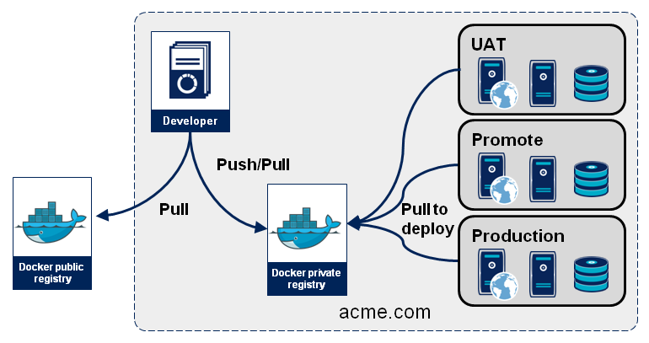
Registries, Repos, and Tags
Images house file system layers and metadata
Repositories are named collections of images
Tags are strings used to identify individual images within a repository
Registries are services that allow you to store and retrieve images by repository:tag name using a REST (HTTP) API
Docker Hub is the central public registry
Companies can deploy their own registries
Using open source and commercial solutions
Docker Trusted Registry (formerly known as: Docker Hub Enterprise) from Docker Inc. (commercial product)
Quay Enterprise part of the Tectonic platform from CoreOS (commercial product)
Docker Registry from Docker Inc. (free open source) (https://github.com/docker/docker-registry)
Artifactory 3.4+ (http://www.jfrog.com/open-source/#os-arti)
Nexus 3 Milestone 5 (in preview) (https://issues.sonatype.org/browse/NEXUS-6166)
Using hosted cloud solutions
Docker Hub (hub.docker.com) from Docker Inc.
Quay (quay.io), acquired by CoreOS Inc.
Google Container Registry (gcr.io) from Google
Amazon EC2 Container Registry [ECR] integrated with AWS EC2 Container Service [ECS]
Public registry images should be used with caution by the security minded

Slide 28
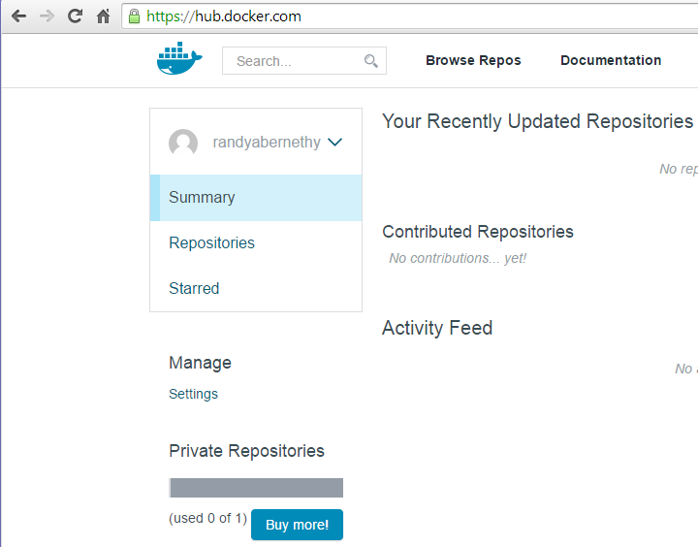
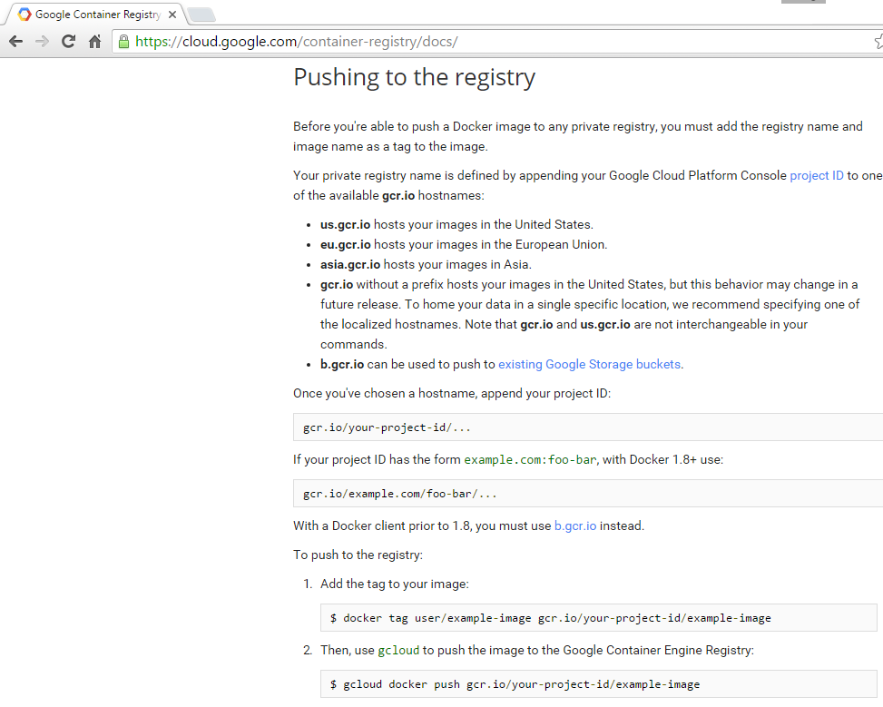
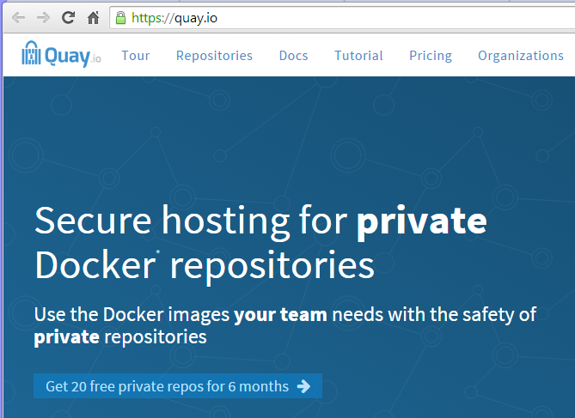
Cloud Registries
Docker Registries house collections of repositories
Registries allow users to upload and download images from repositories
Registries can be private and internal
Organizations can run one or more of their own internal registries
Registries can be public
Docker Hub is a public registry run by Docker Inc.
Docker Hub is integrated into the Docker ecosystem and is the default registry
Other organizations create their own public registries
Registries can be private and external
Companies can offer cloud based registry solutions commercially
Docker Hub hosts private registries
Quay hosts private registries for clients
Acquired by CoreOS Inc. 2014-08
Google hosts a registry service at gcr.io

Slide 29
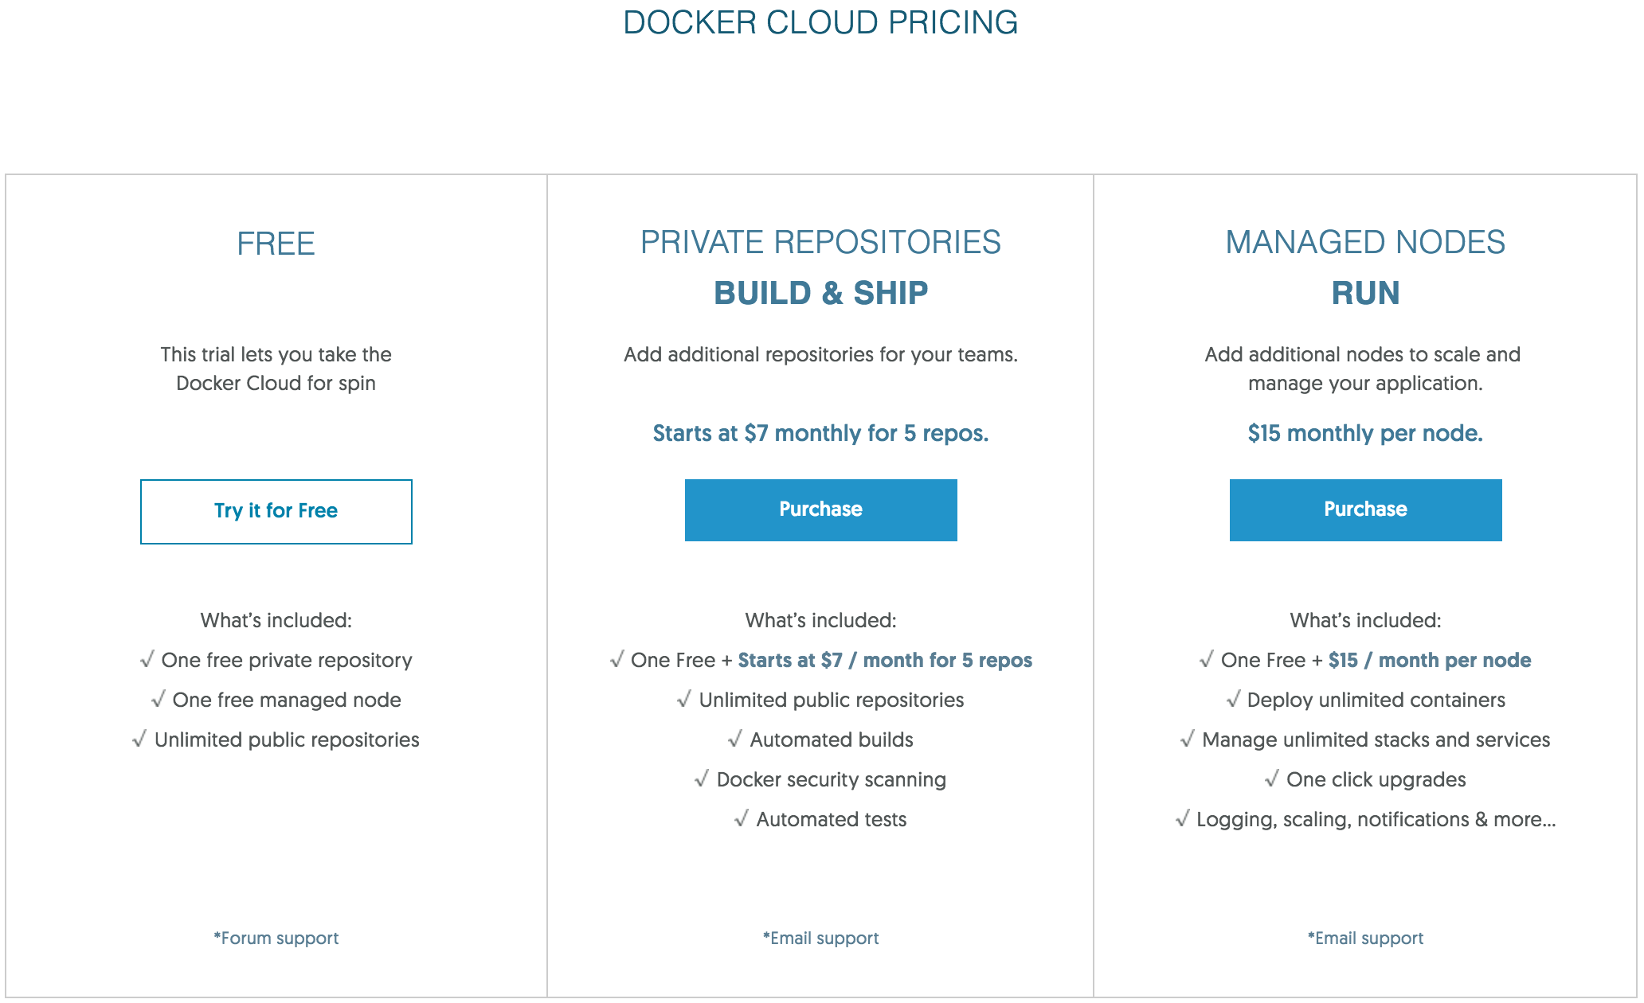
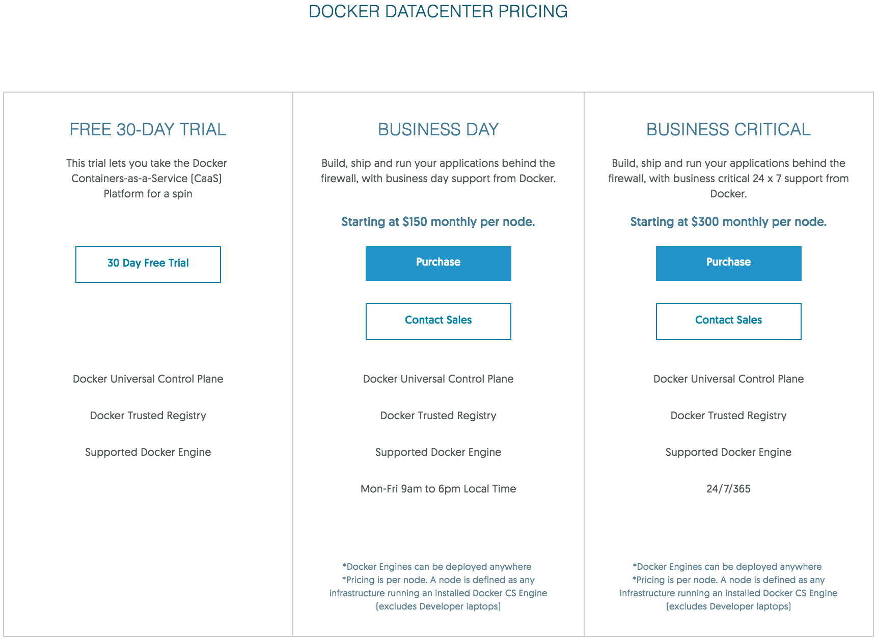
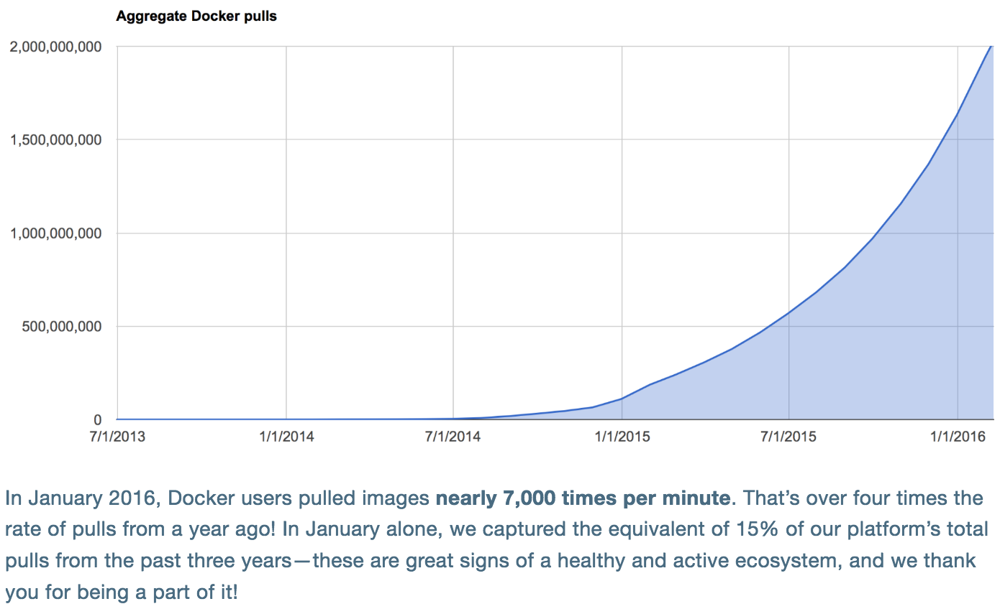
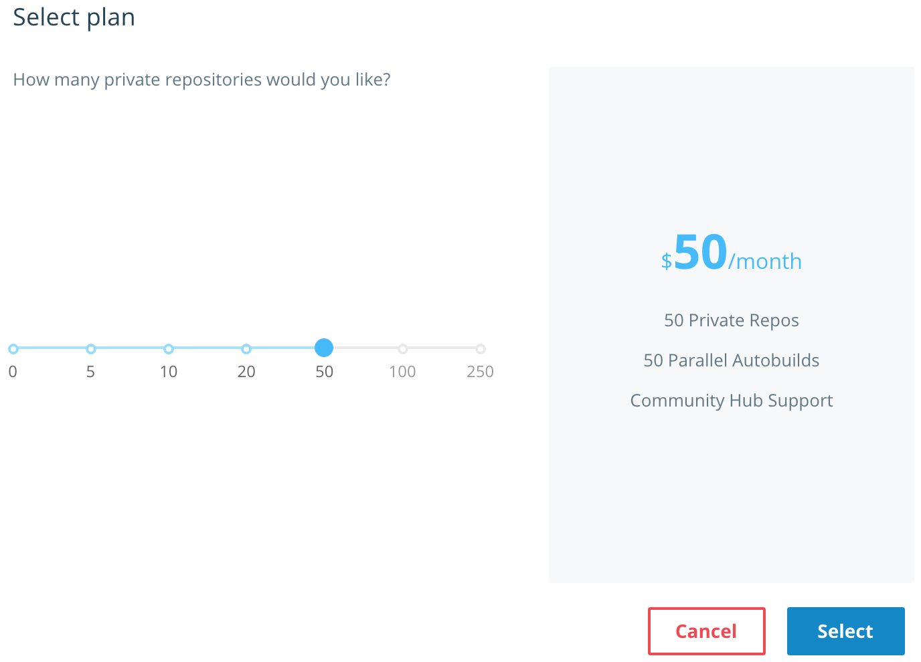
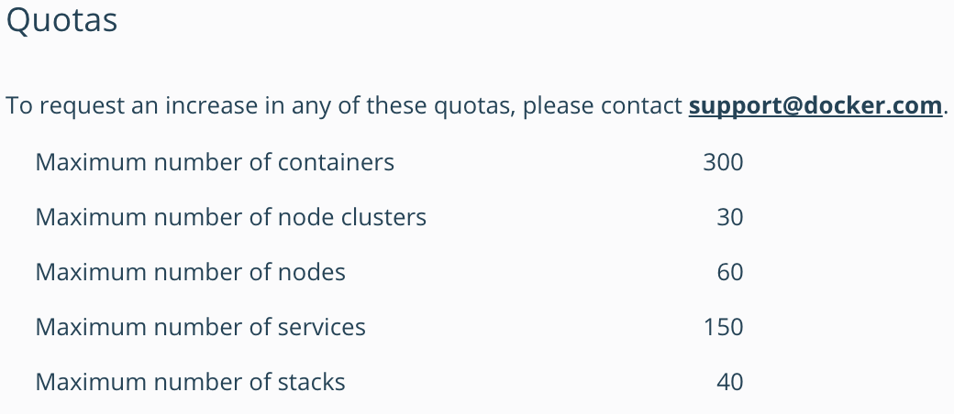
Docker Hub Pricing
https://blog.docker.com/2016/02/docker-hub-two-billion-pulls/

Slide 30
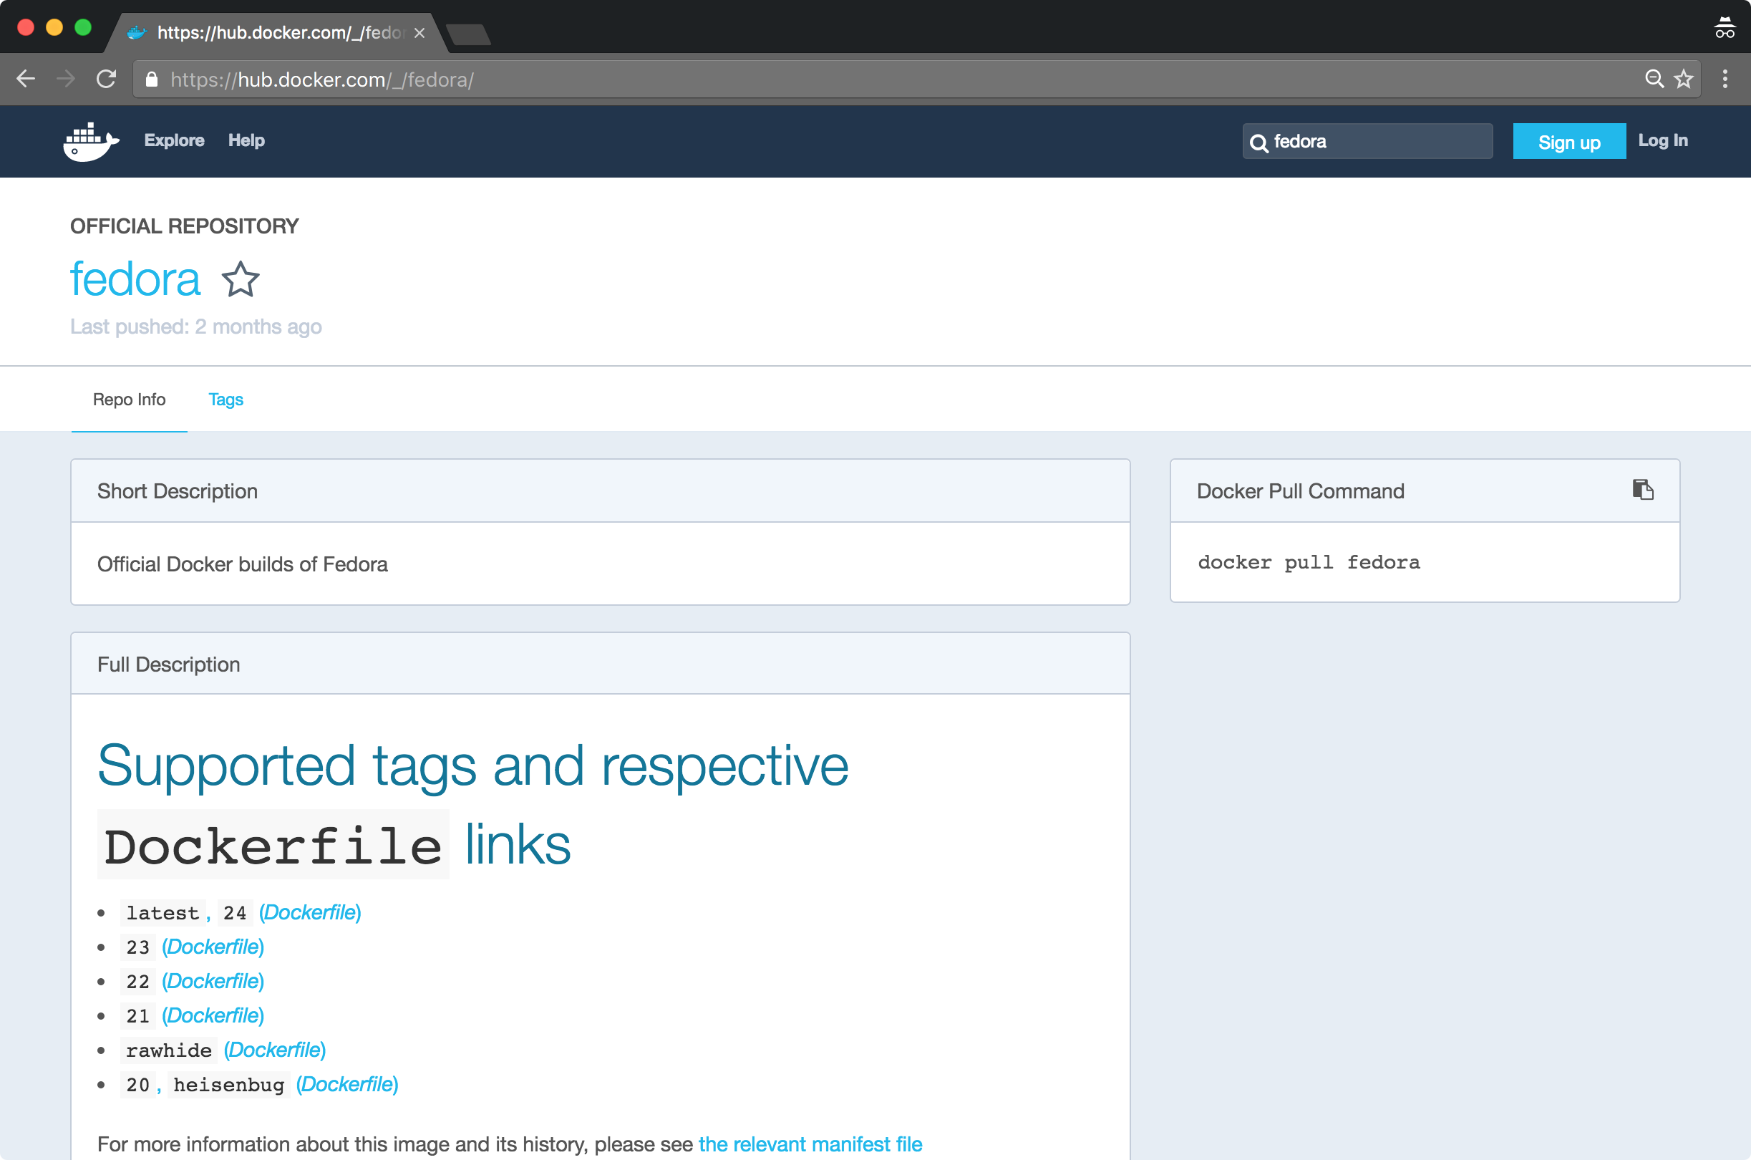
Web Search
Searching for repositories at the command line may suffice for casual lookups
However only basic repository information is returned
The web interface to docker hub provides detailed information on each repository
Including individual tags, long descriptions, dockerfile source and more
$ docker search --help
Usage: docker search [OPTIONS] TERM
Search the Docker Hub for images
Options:
-f, --filter value Filter output based on conditions provided (default [])
--help Print usage
--limit int Max number of search results (default 25)
--no-trunc Don't truncate output

Slide 31
push and pull
Docker daemons maintain a local image store
Daemons push local images to Registries
Docker Daemons pull Registry images to the local store
/var/lib/docker/{aufs, devicemapper, etc.}
Image metadata is stored in /var/lib/docker/graph/
Docker Host
Docker Daemon
Images
Docker Registry
push/pull
Docker Host
Docker Daemon
Images
Images

Slide 32
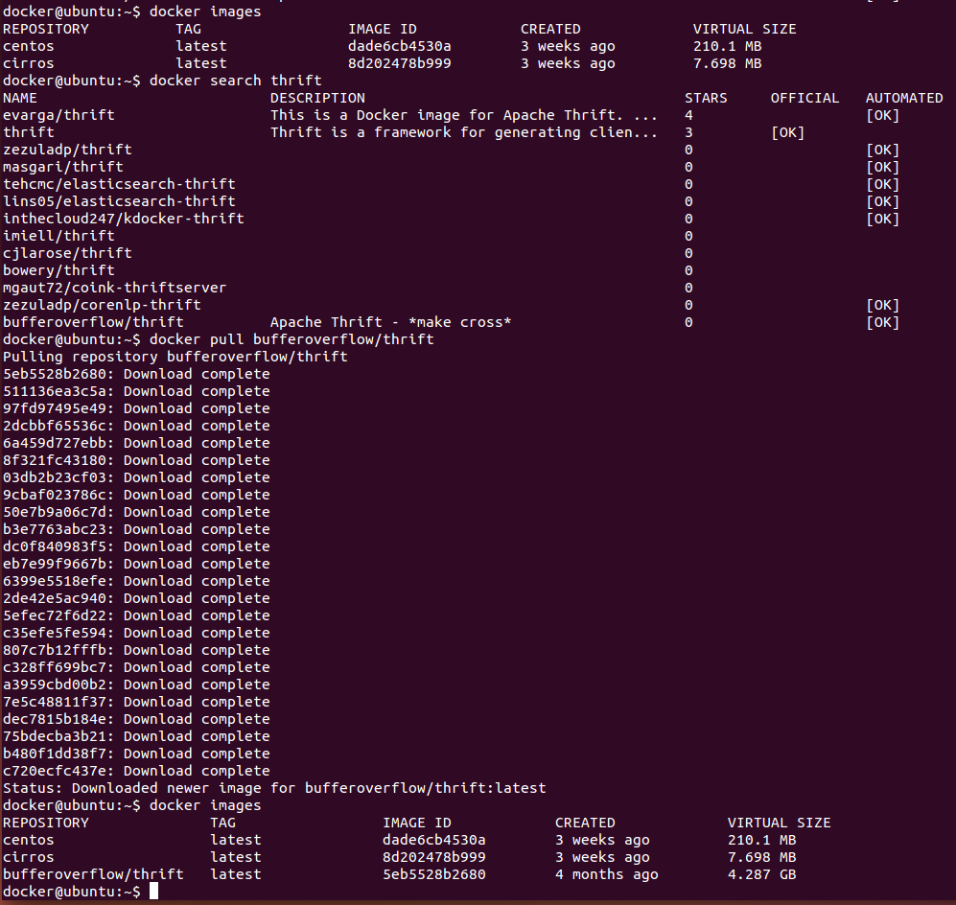
Registry Commands
Docker Registry Commands
docker login
to login to a registry
docker logout
To logout of a registry
docker search
searches a registry for an image
docker pull
pulls an image from registry to the local machine (also pulls its dependencies)
docker push
pushes an image to the registry from local machine
When running a container whose image cannot be found locally, the Docker Engine will try to pull the image from its registry automatically
These commands (and docker run indirectly) cause the Docker daemon to perform network I/O with a registry independent of the docker client session

Slide 33
Accessing Docker Hub
Docker Hub can be searched and pulled anonymously
The Docker command line tool provides a login command
Enables push access to a Docker Hub account from the CLI
Stores credentials in:
~/.dockercfg < docker 1.8
~/.docker/config.json >= docker 1.8
User, password and email can be supplied on the command line
-e, --email="bob@example.com"
-p, --password="secret"
-u, --username="Bob Smith"
Users can login to private registries from the command line also
$ docker login localhost:8080
docker@ubuntu:~$ docker login
Username: bobsmith
Password:
Email: bob@example.com
Login Succeeded
docker@ubuntu:~$

Slide 34
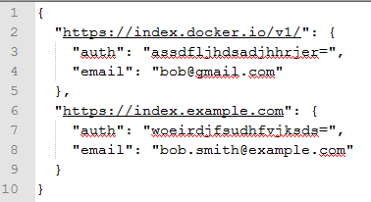
.docker/config.json
.docker/config.json and/or .dockercfg entries provide a registry URL and an auth token
The auth token is a base64 encoded string
base64(<username>:<password>)
This token is usable as long as the account and password on the target host are not changed
This representation is not secure and must be protected through file permissions (600)
The docker login command simply populates this file
This can be automated with a script and/or predefined values can be copied
docker@ubuntu:~$ grep auth .dockercfg | sed 's/.*"auth": "\(.*\)",\?/\1/'
XJfdXNlX3lvdXJlX2RvZ3NfbmFtZV9hc19hX3Bhc3N3b3JkCg=
docker@ubuntu:~$ grep auth .dockercfg | sed 's/.*"auth": "\(.*\)",\?/\1/' | base64 --decode
bobsmith:never_use_your_dogs_name_as_a_password
docker@ubuntu:~$

Slide 35
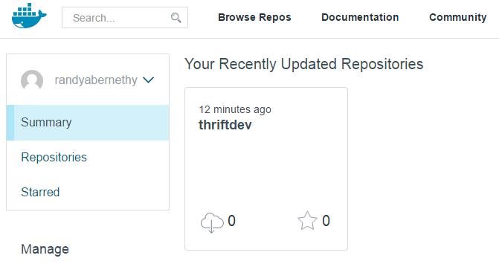
Pushing Repositories
docker@ubuntu:~$ docker help push
Usage: docker push [OPTIONS] NAME[:TAG]
Push an image or a repository to the registry
--help=false Print usage
docker@ubuntu:~$ docker push thriftdev
FATA[0000] You cannot push a "root" repository. Please rename your repository to <user>/<repo> (ex: bobsmith/thriftdev)
docker@ubuntu:~$ docker commit ff808d882430 bobsmith/thriftdev
85905f19abdd41913aa16b9353b606e5dbbd79287a136cae5484df2ceac4dab0
docker@ubuntu:~$ docker images
REPOSITORY TAG IMAGE ID CREATED VIRTUAL SIZE
bobsmith/thriftdev latest 85905f19abdd 7 minutes ago 226 MB
thriftdev latest a69676e13708 9 minutes ago 226 MB
ubuntu trusty 2d24f826cb16 2 weeks ago 188.3 MB
ubuntu trusty-20150218.1 2d24f826cb16 2 weeks ago 188.3 MB
ubuntu 14.04.2 2d24f826cb16 2 weeks ago 188.3 MB
ubuntu latest 2d24f826cb16 2 weeks ago 188.3 MB
ubuntu 14.04 2d24f826cb16 2 weeks ago 188.3 MB
ubuntu precise-20150212 1f80e9ca2ac3 2 weeks ago 131.5 MB
ubuntu 12.04 1f80e9ca2ac3 2 weeks ago 131.5 MB
ubuntu 12.04.5 1f80e9ca2ac3 2 weeks ago 131.5 MB
ubuntu precise 1f80e9ca2ac3 2 weeks ago 131.5 MB
docker@ubuntu:~$ docker push bobsmith/thriftdev
The push refers to a repository [bobsmith/thriftdev] (len: 1)
Sending image list
Pushing repository bobsmith/thriftdev (1 tags)
511136ea3c5a: Image already pushed, skipping
fa4fd76b09ce: Image already pushed, skipping
1c8294cc5160: Image already pushed, skipping
117ee323aaa9: Image already pushed, skipping
2d24f826cb16: Image already pushed, skipping
85905f19abdd: Image successfully pushed
Pushing tag for rev [85905f19abdd] on {https://cdn-registry-1.docker.io/v1/repositories/bobsmith/thriftdev/tags/latest}

Slide 36
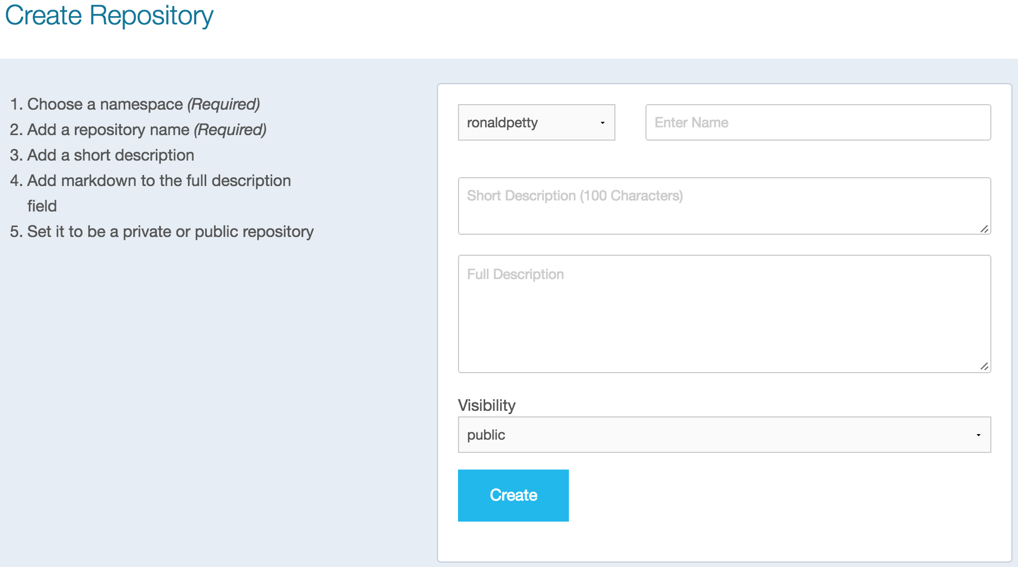
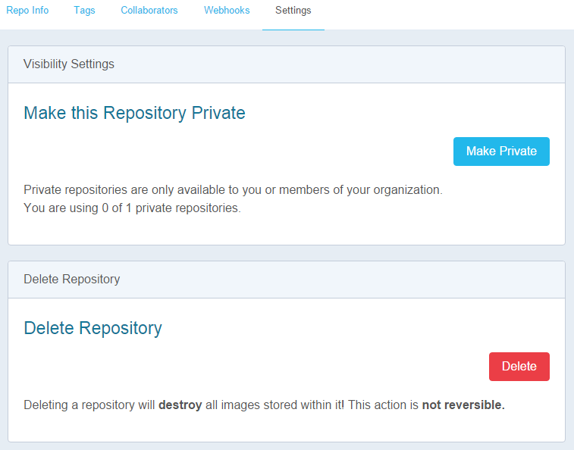
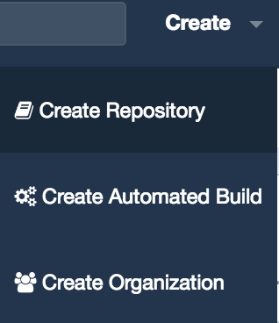
Docker Hub – Private Repos
Private Docker Hub repositories must be added via the Add Repository link on the Docker Hub account page
Once the private repository is created, you can push and pull images to and from it using Docker as always
You must be signed in and have access to work with a private repository
It is not possible to browse or search private repositories on Docker Hub
Private repositories do not get cached
Public repositories do
It is possible to give access to a private repository to those whom you designate (i.e., collaborators) from its Settings page
You can also switch repository status (public to private, or vice-versa)

Slide 37
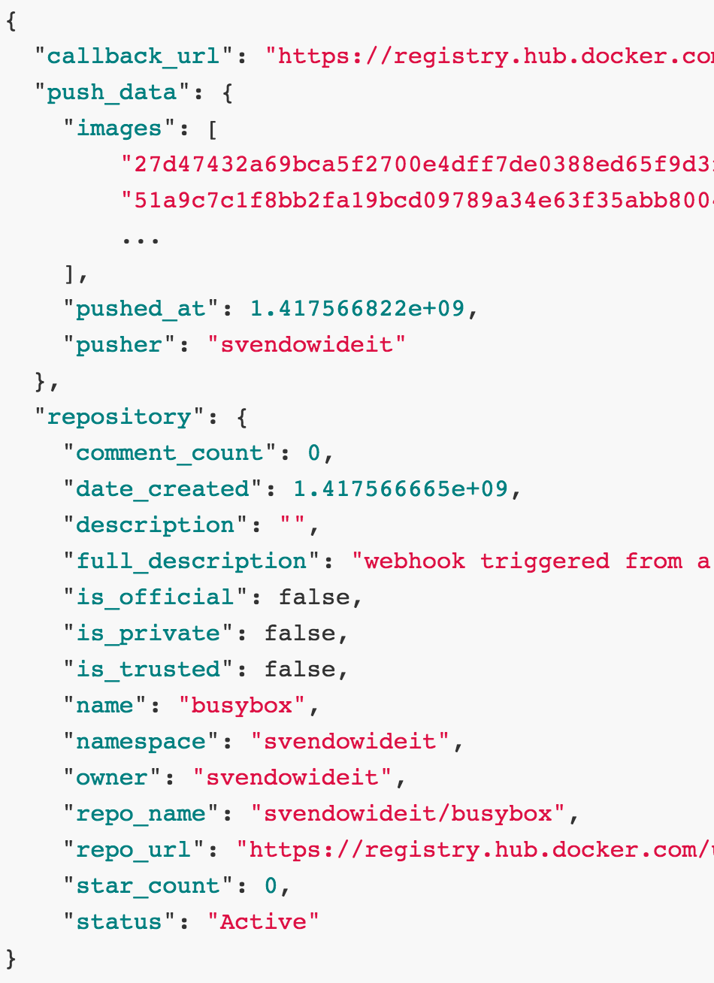
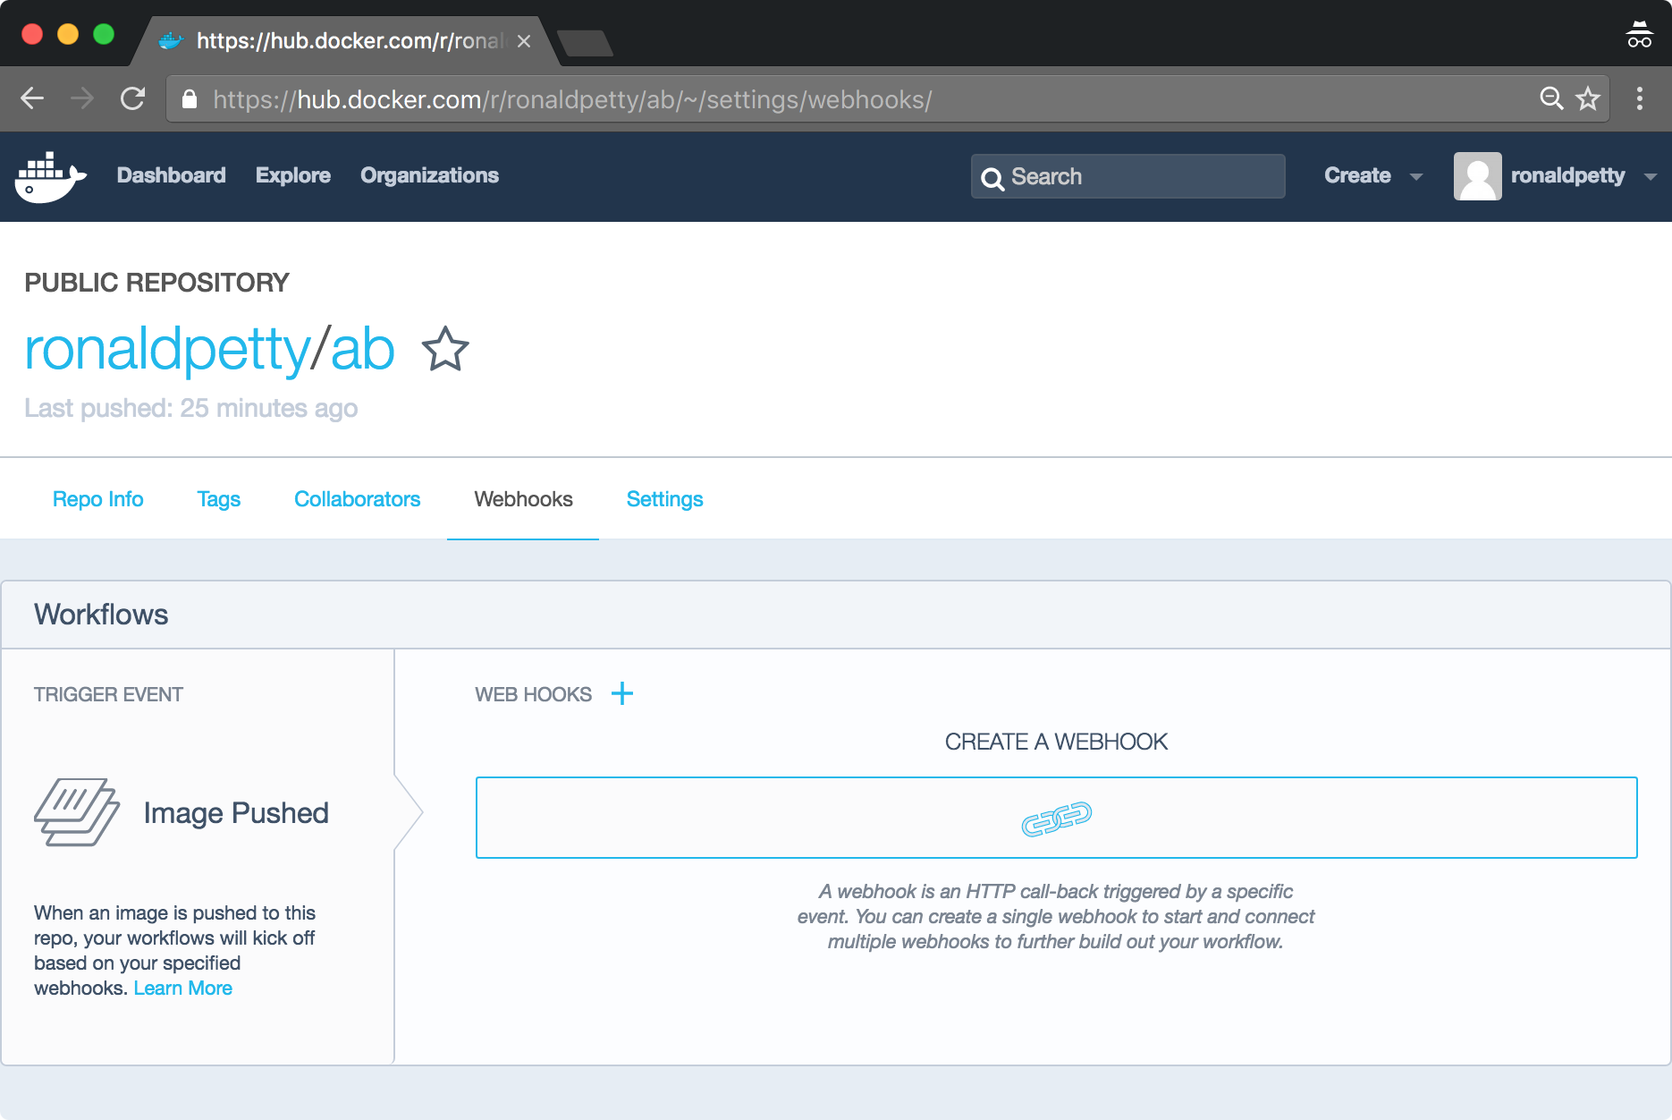
Webhooks
Webhooks allow you to trigger actions following a successful image push to a Docker Hub Repo
Webhooks are configured on the Repository Settings page
A Webhook makes an HTTP POST requests with a JSON payload describing the imaged pushed
You can restrict your service to accept requests from only the Docker Hub server IP Addresses: 162.242.195.64 - 162.242.195.127
When multiple Webhooks are configured they are called in order
Each Web hook can also have multiple URLs (aka. A webhook chain)
Each service in a chain must make a callback POST to the Docker Hub with a JSON body
The body must include a state with a value of success, failure or error
If the state isn't success, the webhook chain is terminated, no further URLs are called

Slide 38
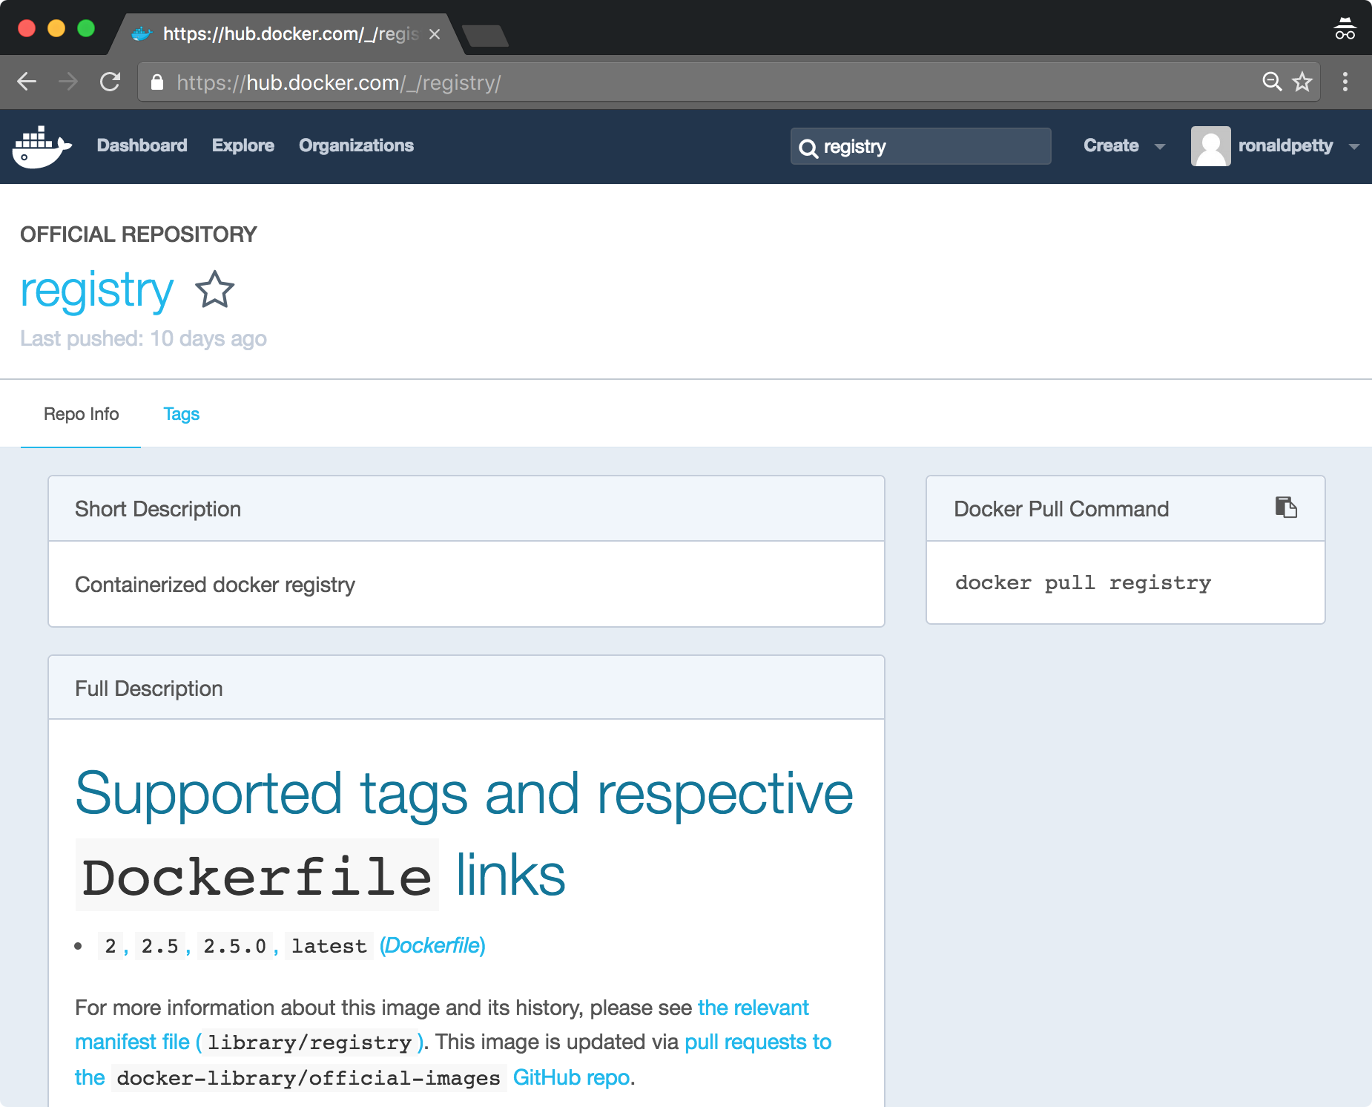
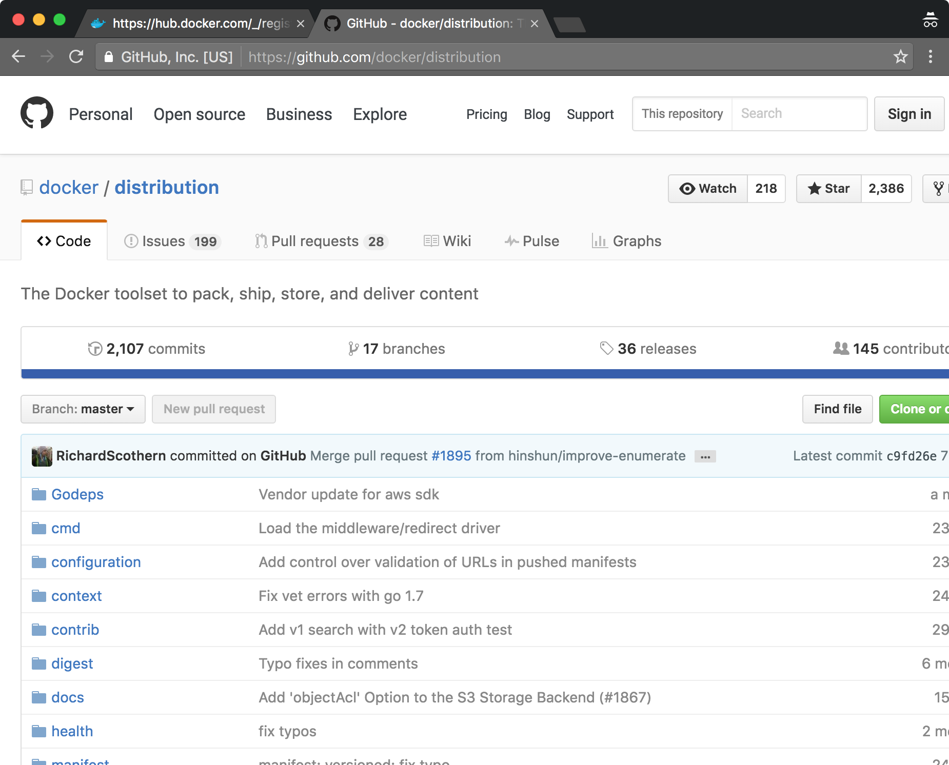
Private Registries
Docker, Inc. provides an open-source Docker registry server
This makes it easy to run a private registry
The registry offers an API but does not currently have a UI
Docker Registry v1 for Docker <= 1.5
Written in Python, serial image download
https://github.com/docker/docker-registry
Docker Registry v2 for Docker >= 1.6
Written in Go, parallel image download
https://docs.docker.com/registry
Beta support for proxying for Docker Hub
Can be run from a Docker Hub image
2015-11-19 Docker < 1.6 push support to Docker Hub removed
2015-12-07 Docker < 1.6 pull support on Docker Hub removed
Docker Registry 2.0 (Docker 1.6)
parallel image download
content addressable images in registry
Registry v1 IDs are random
Registry v2 IDs are sha256 hashes
Docker Registry 2.3 (Docker 1.10)
Parallel image upload
Content addressable images on Docker Host
New manifest format allows registry backend to eliminate image duplicates across repositories

Slide 39
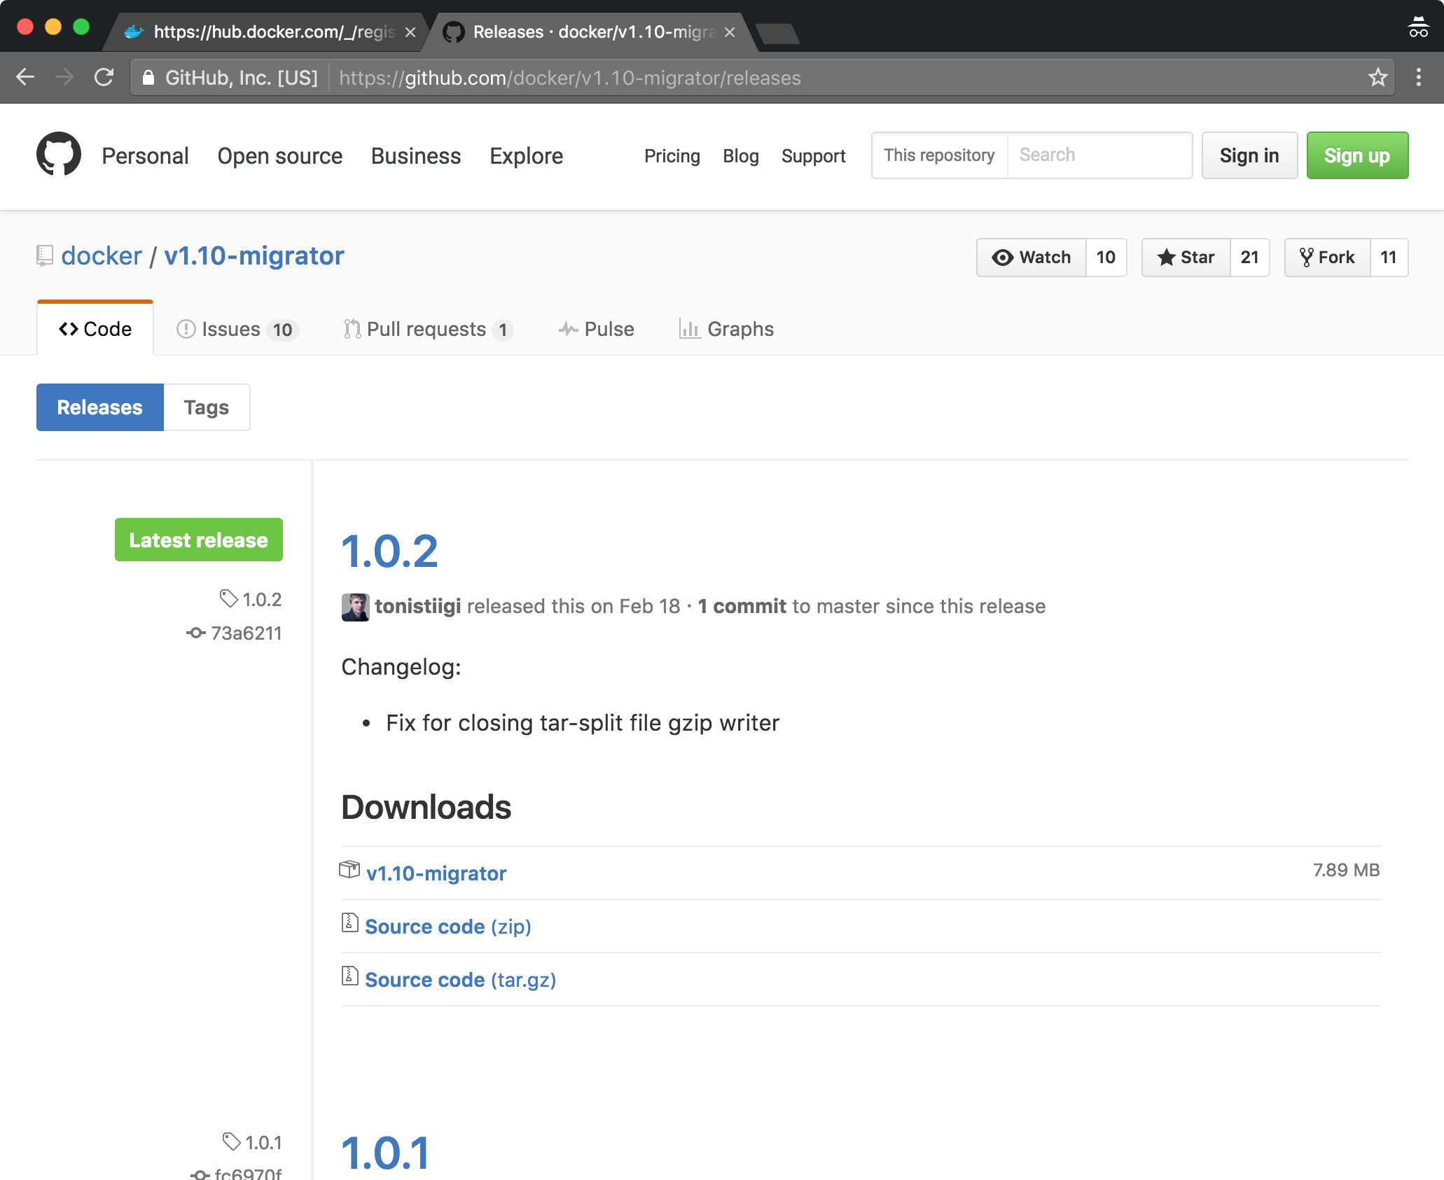
Migrating to Docker v1.10
Docker Engine v1.10 completely changes the way Docker addresses image data on disk
Previously every image and layer used a randomly assigned UUID
In 1.10 IDs are based on a SHA256 hash of the image and layer data
Advantages
Built-in ID collision avoidance
Image data integrity verification
Better layer sharing (even across builds and build systems)
Avoids duplicate downloads
No need to create layers for build instructions that don’t modify the filesystem
New Docker Engine internal “download manager”
Retries on failed downloads
Uploads in parallel
To make current images accessible in v1.10 you must migrate them to the new format
Simply install the latest Docker engine and restart it
All images, tags and containers are automatically migrated to the new format the first time you start an updated Docker daemon
Before loading your container, the Docker daemon will calculate all needed checksums for your current data, and after it has completed, all your images and tags will have brand new IDs
Calculating SHA256 checksums for your files can take time on a host with many images
On average the migrator can process data at a speed of 100MB/s during which time the Docker daemon will be offline
Optionally you can use the image migration tool to migrate images while the current (old) Docker daemon is running
The migrator will pre-calculate all of the SHA hashes allowing the upgraded Docker v1.10 daemon to start immediately
Migrator:
https://github.com/docker/v1.10-migrator/releases
You can run the migrator in a container (of course)
docker run --rm -v /var/lib/docker:/var/lib/docker docker/v1.10-migrator
Use the --privileged switch with devicemapper
https://docs.docker.com/registry/spec/manifest-v2-2/

Slide 40
Running Networked Services in a Container
The Docker Hub curated repository “registry” supports execution of a registry daemon on any Docker platform
$ docker run -p 5000:5000 -d registry:2
The example runs the latest v2 API registry image
Be careful because the “latest” tag points to “0.9.1” as of 1/2016, the old v1.0 Python implementation
The -p switch maps a host port to a container port ([hport]:[cport])
The registry service runs on port 5000 within the container, but the container registry port can be mapped to any host port you like
If the port is not mapped the registry will only be accessible from within the Docker host
v0.9.1 Startup bug
There is a known race condition in this version of the registry code which will crash the service on startup occasionally
Occurs when ./registry._setup_database.lock is referenced before-creation
Add the “-e GUNICORN_OPTS=["--preload"]” switch at the end of the command line (temporary work around) to avoid this bug
Optionally you can just rerun the docker run command until the registry starts successfully
This is not a problem with “registry:2” !
docker@ubuntu:~$ docker run -p 5000:5000 -d registry
692c9188b1c96a1f97891628d0f348a8415b73cdde302da4b0c1f8404854428e
docker@ubuntu:~$ docker ps
CONTAINER ID IMAGE COMMAND CREATED STATUS PORTS NAMES
692c9188b1c9 registry:latest "docker-registry" 11 seconds ago Up 10 seconds 0.0.0.0:5000->5000/tcp happy_elion
docker@ubuntu:~$ curl http://localhost:5000
"\"docker-registry server\"“
docker@ubuntu:~$

Slide 41
Setting Container Environment Variables
You can use environment variables to customize many aspects of the Registry execution
The docker run -e switch sets environment variables in the container
Configuration files can also be used
Sample configurations include support for:
Local file system repository storage
AWS S3
Ceph-S3
Azureblob
Swift, Glance and Glance-Swift
Others…
Further Registry Documentation
https://docs.docker.com/registry/
v1 code and info:
https://github.com/docker/docker-registry/blob/master/README.md
https://github.com/docker/docker-registry/blob/master/ADVANCED.md
v2 code and info:
https://github.com/docker/distribution
You can use:
docker run --env-file <filename>
To load a set of environment variables from a file
docker run \
-e SETTINGS_FLAVOR=s3 \
-e AWS_BUCKET=acme-docker \
-e STORAGE_PATH=/registry \
-e AWS_KEY=AKIAHSHB43HS3J92MXZ \
-e AWS_SECRET=xdDowwlK7TJajV1Y7EoOZrmuPEJlHYcNP2k4j49T \
-e SEARCH_BACKEND=sqlalchemy \
-p 5000:5000 \
registry

Slide 42
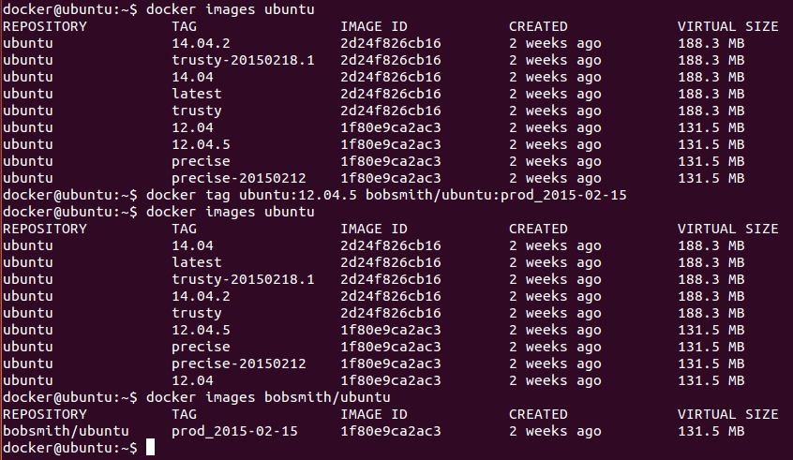
docker tag
The docker tag subcommand allows you to create a new repository name and/or tag for an existing image
Think of this as a hard link (e.g. $ ln source newlink )
Tag is useful as it allows you to format repository names and tags to suit various registry systems

Slide 43
Pushing to a private Registry
This example creates a new container and then commits an image from it
To push the image to a registry the registry URL must be the first part of the repository name
Or a user name to imply pushing to the default Docker Hub
Because repository names and tags are simply aliases, a single image ID may have many names/tags
docker@ubuntu:~$ docker run -t -i ubuntu:14.04 /bin/bash
root@335a181a7be6:/#
### Do some configuring
root@335a181a7be6:/# exit
exit
docker@ubuntu:~$ docker commit 335a181a7be6 bobsmith/thriftdev
84e5bc36d1640aef7cd5be9dba32297ab78d3685312859def2145059a0b0cf32
docker@ubuntu:~$ docker images
REPOSITORY TAG IMAGE ID CREATED VIRTUAL SIZE
bobsmith/thriftdev latest 84e5bc36d164 10 seconds ago 226 MB
ubuntu latest 2d24f826cb16 2 weeks ago 188.3 MB
ubuntu trusty 2d24f826cb16 2 weeks ago 188.3 MB
ubuntu trusty-20150218.1 2d24f826cb16 2 weeks ago 188.3 MB
ubuntu 14.04 2d24f826cb16 2 weeks ago 188.3 MB
ubuntu 14.04.2 2d24f826cb16 2 weeks ago 188.3 MB
docker@ubuntu:~$ docker tag bobsmith/thriftdev localhost:5000/thriftdev
docker@ubuntu:~$ docker images
REPOSITORY TAG IMAGE ID CREATED VIRTUAL SIZE
bobsmith/thriftdev latest 84e5bc36d164 2 minutes ago 226 MB
localhost:5000/thriftdev latest 84e5bc36d164 2 minutes ago 226 MB
ubuntu 14.04 2d24f826cb16 2 weeks ago 188.3 MB
ubuntu latest 2d24f826cb16 2 weeks ago 188.3 MB
ubuntu trusty 2d24f826cb16 2 weeks ago 188.3 MB
ubuntu 14.04.2 2d24f826cb16 2 weeks ago 188.3 MB
ubuntu trusty-20150218.1 2d24f826cb16 2 weeks ago 188.3 MB
docker@ubuntu:~$ docker push localhost:5000/thriftdev
The push refers to a repository [localhost:5000/thriftdev] (len: 1)
Sending image list
Pushing repository localhost:5000/thriftdev (1 tags)
511136ea3c5a: Image successfully pushed
fa4fd76b09ce: Image successfully pushed
1c8294cc5160: Image successfully pushed
117ee323aaa9: Image successfully pushed
2d24f826cb16: Image successfully pushed
84e5bc36d164: Image successfully pushed
Pushing tag for rev [84e5bc36d164] on {http://localhost:5000/v1/repositories/thriftdev/tags/latest}
docker@ubuntu:~$

Slide 44
Pulling Images
Repository names embed the information used to identify an image’s registry
For Docker Hub
uid/name
For non Docker Hub:
url/name
This allows Docker to automatically recover missing images from the appropriate registry
Images can be pulled or run by registry name and optional tag
docker@ubuntu:~$ docker images
REPOSITORY TAG IMAGE ID CREATED VIRTUAL SIZE
localhost:5000/thriftdev latest 84e5bc36d164 24 minutes ago 226 MB
ubuntu trusty 2d24f826cb16 2 weeks ago 188.3 MB
ubuntu 14.04 2d24f826cb16 2 weeks ago 188.3 MB
ubuntu latest 2d24f826cb16 2 weeks ago 188.3 MB
ubuntu trusty-20150218.1 2d24f826cb16 2 weeks ago 188.3 MB
ubuntu 14.04.2 2d24f826cb16 2 weeks ago 188.3 MB
docker@ubuntu:~$ docker rmi localhost:5000/thriftdev
Untagged: localhost:5000/thriftdev:latest
Deleted: 84e5bc36d1640aef7cd5be9dba32297ab78d3685312859def2145059a0b0cf32
docker@ubuntu:~$ docker images
REPOSITORY TAG IMAGE ID CREATED VIRTUAL SIZE
ubuntu trusty 2d24f826cb16 2 weeks ago 188.3 MB
ubuntu trusty-20150218.1 2d24f826cb16 2 weeks ago 188.3 MB
ubuntu 14.04 2d24f826cb16 2 weeks ago 188.3 MB
ubuntu latest 2d24f826cb16 2 weeks ago 188.3 MB
ubuntu 14.04.2 2d24f826cb16 2 weeks ago 188.3 MB
docker@ubuntu:~$ docker run -t -i localhost:5000/thriftdev:latest /bin/bash
Unable to find image 'localhost:5000/thriftdev:latest' locally
Pulling repository localhost:5000/thriftdev
84e5bc36d164: Download complete
511136ea3c5a: Download complete
fa4fd76b09ce: Download complete
1c8294cc5160: Download complete
117ee323aaa9: Download complete
2d24f826cb16: Download complete
Status: Downloaded newer image for localhost:5000/thriftdev:latest
root@a89e744e7d1d:/# exit
exit
docker@ubuntu:~$ docker images
REPOSITORY TAG IMAGE ID CREATED VIRTUAL SIZE
localhost:5000/thriftdev latest 84e5bc36d164 28 minutes ago 226 MB
ubuntu trusty-20150218.1 2d24f826cb16 2 weeks ago 188.3 MB
ubuntu trusty 2d24f826cb16 2 weeks ago 188.3 MB
ubuntu 14.04 2d24f826cb16 2 weeks ago 188.3 MB
ubuntu 14.04.2 2d24f826cb16 2 weeks ago 188.3 MB
ubuntu latest 2d24f826cb16 2 weeks ago 188.3 MB

Slide 45
Summary
Registries provide centralized lookup and storage facilities for repositories and their images
Docker Registry lookups are based on x[/y[/z]][:t] formatted names
/ reserved character separating discrete components of the image path
: reserved character separating repository path from image tag (also separates hostname from port in x position)
t is the image tag name and defaults to “latest” if not present
x lookups refer an official Docker Hub repository name (“ubuntu”)
x/y lookups
namespace/repo form: x is a DockerHub namespace (account/user name), y is the repository name (fred/specialrepo)
host/repo form: x is the registry hostname[:port], y is the repository name (reg.example.com:5005/specialrepo)
x/y/z lookups interpret x as registry hostname:port, y as namespace and z as the repository name
e.g. “reg.example.com:5005/fred/specialrepo:latest” [FQIN??]
The Docker Registry code can be executed directly from images found on Docker Hub
Source is also available on github
Networked services can run in containers using the -p switch to map host ports to container ports
Docker supplies several commands to support registry operations
docker login *
docker logout
docker search *
docker pull *
docker push *
docker tag (creates appropriate names for image registry operations)
docker run/build/create (implicitly pull missing images) *
* Only these commands cause Docker engine to interact with Registries

Slide 46
Lab 2
Working with Images and Registries

Slide 47
3: Dockerfiles I

Slide 48
Objectives
Explain the purpose of Dockerfiles
List the main Dockerfile instructions
Understand the docker build process
Examine important Dockerfile concepts
Build Cache
Build Triggers

Slide 49
Dockerfiles and Context
Docker can build images automatically by reading the instructions from a Dockerfile
A Dockerfile is a text document that contains all the commands you would normally execute manually in order to build a Docker image
By calling docker build from your terminal, you can have Docker construct your image step by step, executing the instructions successively
# docker build /some/path/
The path supplied to docker build is the context of the build
Also known as the source repository
The build is run by the Docker engine, not by the CLI, so the whole context must be transferred to the daemon
The Docker CLI reports "Sending build context to Docker daemon" when the context is sent to the daemon
Therefore, in most cases it is best to put each Dockerfile in an empty directory, adding only the files needed for building that Dockerfile
This minimizes the context transferred to the Docker daemon
Use .dockerignore to control what files to not transfer
https://docs.docker.com/engine/reference/builder/#/dockerignore-file

Slide 50
Dockerfiles
user@ubuntu:~$ mkdir thriftdev
user@ubuntu:~$ cd thriftdev
user@ubuntu:~/thriftdev$ vim dockerfile
user@ubuntu:~/thriftdev$ cat dockerfile
# Version: 1.0.0
FROM ubuntu:14.04
MAINTAINER Bob Smith "bob@example.com"
RUN apt-get update
RUN apt-get install -y git
RUN echo 'thrift dev image v1.0.0' > /README.md
LABEL license "Apache 2.0"
user@ubuntu:~/thriftdev$ docker build -t my-thrift-image .
Sending build context to Docker daemon 2.048 kB
Step 1 : FROM ubuntu:14.04
---> b72889fa879c
Step 2 : MAINTAINER Bob Smith "bob@example.com"
---> Running in 9e9c5d061e45
---> f768c2270a02
Removing intermediate container 9e9c5d061e45
Step 3 : RUN apt-get update
---> Running in 2a49c5457c26
...
---> 10c6eacbc55b
Removing intermediate container 2a49c5457c26
Step 4 : RUN apt-get install -y git
---> Running in f129e6217fad
...
---> 78a6f751fbe2
Removing intermediate container f129e6217fad
Step 5 : RUN echo 'thrift dev image v1.0.0' > /README.md
---> Running in 222735f19aef
---> ce4a7261a4d2
Removing intermediate container 222735f19aef
Step 6 : LABEL license "Apache 2.0"
---> Running in a0969b45283f
---> ed1726b77df1
Removing intermediate container a0969b45283f
Successfully built ed1726b77df1
user@ubuntu:~/thriftdev$ ls -l
total 4
-rw-rw-r-- 1 user user 200 Apr 19 07:42 dockerfile
user@ubuntu:~/thriftdev$
docker commit
A practical way to create images interactively
An impractical way to create identical or incrementally improved images
docker build
The docker build command creates images automatically from a Dockerfile
Dockerfile
A text document containing all the commands you would normally execute manually in order to build a Docker image with docker commit
To build an image you can place a file called “Dockerfile” at the root of your repository and call “docker build” with the path of your source repository
$ docker build .
Each command in a Dockerfile creates a new image layer
user@ubuntu:~/thriftdev$ docker images -a
REPOSITORY TAG IMAGE ID CREATED SIZE
my-thrift-image latest ed1726b77df1 9 minutes ago 247.6 MB
<none> <none> ce4a7261a4d2 9 minutes ago 247.6 MB
<none> <none> 78a6f751fbe2 9 minutes ago 247.6 MB
<none> <none> 10c6eacbc55b 10 minutes ago 209.7 MB
<none> <none> f768c2270a02 10 minutes ago 188 MB
ubuntu 14.04 b72889fa879c 5 days ago 188 MB

Slide 51
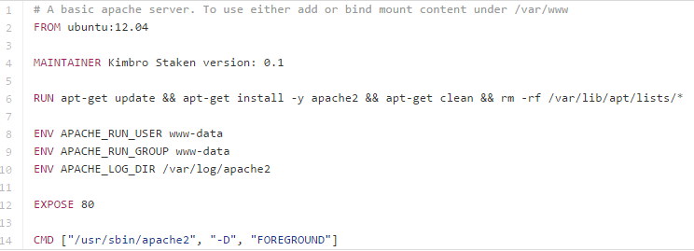
Dockerfile Processing
A Dockerfile contains a series of instructions paired with arguments
Each instruction should be in upper-case and be followed by an argument
FROM ubuntu:14.04
Instructions are processed from the top down
The ordering of instructions is typically important
Each instruction commits a new image layer
To execute an instruction Docker:
Runs a container from the previous image
Executes the instruction on the container
Commits a new image from the modified container (may be metadata only)
Deletes the working container
Repeats for the next instruction until all instructions have been applied
If one of the instruction in the Dockerfile build crashes you will still have all of the images leading up to the failed step
This is useful for debugging
Source: https://github.com/kstaken/dockerfile-examples/blob/master/apache/Dockerfile
Several great examples here

Slide 52
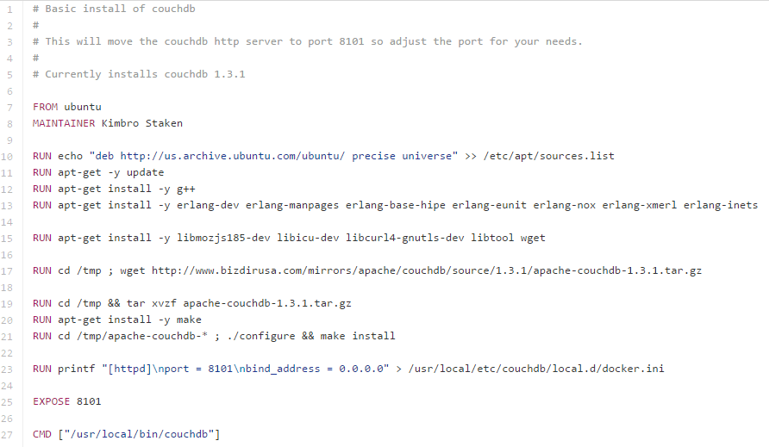
Dockerfile construction
FROM
Should always be the first instruction
Specifies a base image that the Dockerfile will operate on
MAINTAINER
Tells Docker the author’s name and email
RUN
Executes commands on the current image
RUN instructions execute in a shell using the command wrapper /bin/sh –c
If you wish to execute without a shell (for example, to avoid shell string munging), you can specify the instruction in exec format:
RUN [ "apt-get", " install", "-y", "nginx" ]
An array specifies the command to be executed and each parameter to pass to the command
EXPOSE
Tells Docker that the application in this container will use this specific port in the container
You must map the port to the host using the docker run command to make it externally available
You can specify multiple EXPOSE instructions
CMD
Defines an executable for a container
CMD has several forms:
CMD ["executable","param1","param2"] (exec form)
CMD command param1 param2 (shell form, performs shell processing on the provided command line [e.g. $HOME substitution, etc.])
There should only be one CMD instruction in a Dockerfile
The CMD will not be executed if an executable is specified on the docker run command line
e.g.: $ docker run –t –i ubuntu /bin/bash

Slide 53
Docker build options
Building from a git repository
Rather than specifying a local directory, build can be given a git repo url
Clones the repository and uses the cloned repository as context
Uses the Dockerfile at the root of the repository
You can specify a Git repository using the git:// scheme
docker build -t="bobs/thrift:v1" git://github.com/bobs/thriftdev
-f
Allows you to specify a particular file to use as the build input rather than ./Dockerfile
Added in Docker v1.5
-t
The tag switch allows you to name repositories ([userid, url]/reponame) and add tags (:0.9.2)
--no-cache=[true, false]
The Docker build cache stores copies of previously created images
While building Docker will look for an existing image in its cache that it can reuse
Use to turn off caching
Instructions are compared against all child images of the base image to see if one was built using the exact same instruction
user@ubuntu:~$ time docker build -t bobsmith/thriftdev:0.1.0 thriftdev
Sending build context to Docker daemon 2.048 kB
Step 1 : FROM ubuntu:14.04
---> b72889fa879c
Step 2 : MAINTAINER Bob Smith "bob@example.com"
---> Using cache
---> f768c2270a02
Step 3 : RUN apt-get update
---> Using cache
---> 10c6eacbc55b
Step 4 : RUN apt-get install -y git
---> Using cache
---> 78a6f751fbe2
Step 5 : RUN echo 'thrift dev image v1.0.0' > /README.md
---> Using cache
---> ce4a7261a4d2
Step 6 : LABEL license "Apache 2.0"
---> Using cache
---> ed1726b77df1
Successfully built ed1726b77df1
real 0m0.041s
user 0m0.000s
sys 0m0.019s
user@ubuntu:~$

Slide 54
Build Cache
The build cache allows multiple Dockerfiles to share the same image layers over a common base
This optimizes build times and saves disk space
Maximizing cache use requires careful layout of container commonalities
There are also operational considerations
For example, all commands are run at build time
Thus an image’s repository index may grow old if the image is not rebuilt
The example below uses an ENV instruction to force the follow on images to be rebuilt when the REFRESHED_AT date is updated
FROM ubuntu: 14.04
MAINTAINER Bob Smith "bob@example.com"
ENV REFRESHED_AT 2015-02-01
RUN apt-get -qq update

Slide 55
Image History
The history command displays the parents of a given image and the instructions which created them
each line displays:
image UUID
time created
executed statement creating the image
size added to the overall file system by the command
You can use the --no-trunc switch to view the entire create command
allows you to rebuild the original Dockerfile if need be
scripts can easily automate the Dockerfile reverse engineering process
https://github.com/CenturyLinkLabs/dockerfile-from-image
note: Having the Dockerfile is not enough to rebuild most images, you will also need all of the binaries, libs and sources copied into the images with COPY/ADD/etc…
docker@ubuntu:~$ docker history bobsmith/thriftdev:0.1.0
IMAGE CREATED CREATED BY SIZE
99fdcb5de9a4 4 hours ago /bin/sh -c #(nop) EXPOSE 80/tcp 0 B
9fa98b0dc393 4 hours ago /bin/sh -c echo 'thrift dev image v1.0.0' > / 24 B
3c0ab41341eb 4 hours ago /bin/sh -c apt-get install -y git 37.69 MB
1c09982ab4ce 4 hours ago /bin/sh -c apt-get update 20.59 MB
3cb1d6967c66 4 hours ago /bin/sh -c #(nop) MAINTAINER Bob Smith "bob@e 0 B
2d24f826cb16 2 weeks ago /bin/sh -c #(nop) CMD [/bin/bash] 0 B
117ee323aaa9 2 weeks ago /bin/sh -c sed -i 's/^#\s*\(deb.*universe\)$/ 1.895 kB
1c8294cc5160 2 weeks ago /bin/sh -c echo '#!/bin/sh' > /usr/sbin/polic 194.5 kB
fa4fd76b09ce 2 weeks ago /bin/sh -c #(nop) ADD file:0018ff77d038472f52 188.1 MB
511136ea3c5a 21 months ago 0 B

Slide 56
Additional Dockerfile Instructions
CMD sets a command/arguments to run in the image if no arguments are passed to docker run
ENTRYPOINT makes your image behave like a binary
ENTRYPOINT
Runs the specified program
ENTRYPOINT ["/usr/ sbin/nginx"]
Unlike CMD, additional arguments supplied to a docker run of an image with an ENTRYPOINT are supplied directly to the ENTRYPOINT program
If CMD and ENTRYPOINT are present the CMD array is passed to the ENTRYPOINT program as parameters and overridden if command line args are supplied during docker run
This allows for natural “command style” execution of containers:
Assuming thrift is an image with an entry point that runs the thrift compiler:
$ docker run thrift --gen java appcore.thrift
ENV
Sets environment variables
Environment variables can be referenced in many docker instructions using a $ prefix
Environment variables can also be set on the docker run command line using the –e switch
The following Dockerfile instructions can handle environment variables as arguments: ENV, ADD, COPY, WORKDIR, EXPOSE, VOLUME, USER
ENV APP_DIR /home/webapp/
WORKDIR $APP_DIR
LABEL
Adds metadata to an image (e.g. LABEL version="1.0“)
USER
specifies a user:group that the image should be run as (by name or id)
Can specify a user (“bob”) or a user and group (“bob:emp”)
WORKDIR
Sets the working directory for the container and the ENTRYPOINT/CMD
LABEL version="1.0"
USER webapp
ENV APP_DIR /home/webapp/
WORKDIR /opt/webapp/db
RUN bundle install
WORKDIR /home/webapp/
ENTRYPOINT [ "rackup" ]

Slide 57
Using ENVs in a Dockerfile
Environment variables declared with the ENV statement can be used in Dockerfile instructions
Notated in the Dockerfile either with $variable_name or ${variable_name}
Environment variables are supported by the following instructions:
ADD
COPY
ENV
EXPOSE
LABEL
USER
WORKDIR
VOLUME
STOPSIGNAL
LABEL version="1.0"
USER webapp
ENV APP_DIR /home/webapp/
WORKDIR /opt/webapp/db
RUN bundle install
WORKDIR $APP_DIR
ENTRYPOINT [ "rackup" ]

Slide 58
Summary
Dockerfiles allow Docker images to be scripted
This makes image construction highly repeatable
There are several key Dockerfile instructions and each creates a separate image
The Docker build cache saves copies of each instruction’s image, potentially speeding up future builds
Dockerfile Documentation:
https://docs.docker.com/reference/builder/

Slide 59
Lab 3
Creating Dockerfiles

Slide 60
4: Dockerfiles II

Slide 61
Objectives
Explore advanced Dockerfile instructions
Understand GitHub and Automated Builds
Learn Dockerfile best practices
Examine the Docker Hub standard library
Try filtering and formatting image lists
Explain the nature of
docker load and docker save
docker import and docker export

Slide 62
ADD & COPY
ADD
Adds files and directories from the build environment into the image
Specifies a source and a destination for files:
ADD software.lic /opt/application/software.lic
Copies software.lic from the build directory to /opt/application/software.lic in the image
The source of the file can be a URL, filename, or directory
The source must be inside the build context
If the destination ends in a /, docker considers the source a directory
ADD will automatically unpack source archives
gzip
bzip2
xz
New files and directories will be created with a mode of 0755 and a UID and GID of 0
COPY
Does is almost exactly like ADD but without URL and Archive support
To speed the build and keep images lean you can exclude files and directories when COPYing or ADDing to the image by adding a .dockerignore file to the context directory

Slide 63
ONBUILD
ONBUILD adds triggers to images
A trigger is executed when the image is used as the basis of another image
Uses:
Creating an image that needs source code from a specific location that is not yet available
Execute a build script specific to the environment in which the image is built
Triggers insert a new instruction in the build process, as if it were specified right after the FROM instruction
The trigger can be any build instruction except FROM, MAINTAINER, and ONBUILD
ONBUILD triggers are executed in the order specified in the parent image and are only inherited once
by children, not grandchildren
# bobs/apache
FROM ubuntu: 14.04
MAINTAINER Bob Smith "bob@example.com"
RUN apt-get update
RUN apt-get install -y apache2
ENV APACHE_RUN_USER www-data
ENV APACHE_RUN_GROUP www-data
ENV APACHE_LOG_DIR /var/log/apache2
ONBUILD ADD . /var/www/
EXPOSE 80
ENTRYPOINT ["/usr/sbin/apache2"]
CMD ["-D", "FOREGROUND"]
# bobs/webapp
# The important parts of this image
# are the static files in the build
# dir.
FROM bobs/apache
### BUILD TRIGGER happens here
MAINTAINER Bob Smith "bob@example.com" ENV APPLICATION_NAME webapp
ENV ENVIRONMENT development

Slide 64
VOLUME
VOLUME
Creates a mount point with the specified name
More on volumes in the next chapter
The value can be
VOLUME /var/log
VOLUME /var/log /var/db
VOLUME ["/var/log/", "/var/db/"]
The docker run command initializes the newly created volume with any data that exists at the specified location within the base image
FROM ubuntu
RUN mkdir /myvol
RUN echo "hello world" > /myvol/greeting
VOLUME /myvol
Results in an image that causes docker run, to create a new volume and to mount it at /myvol, then to copy the greeting file into the newly created volume
Note: data changed within the volume by build steps after the volume is declared will be discarded

Slide 65
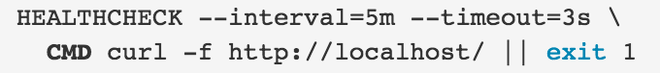
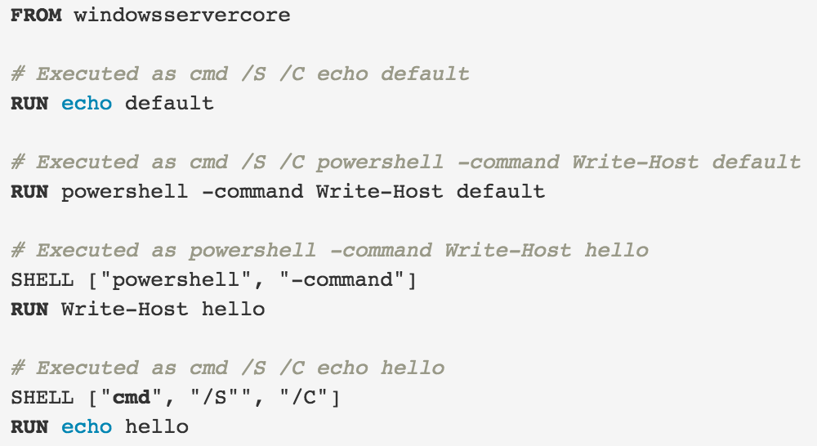
New Dockerfile instructions
$ docker build --build-arg user=frodo .
Docker 1.9 adds two new Dockerfile instructions
ARG - defines a variable that users can pass at build-time
STOPSIGNAL - sets the signal that will be sent to the container by docker stop (SIGTERM is the default)
Docker 1.12 adds two new Dockerfile instructions
HEALTHCHECK - tells Docker how to test a container to check that it is still working
SHELL - allows the default shell used for the shell form of commands to be overridden
#parameterized Dockerfile
FROM busybox
ARG user
USER $user
STOPSIGNAL SIGHUP

Slide 66

Compound Dockerfiles
Dockerfiles can contain multiple FROM statements
Each FROM defines a new Image stack build
Like building separate Dockerfiles which share the same context

Slide 67


Building Git Repos
docker build can be passed a GitHub URL as a context
The client recursively clones the repository and its submodules using a git clone --depth 1 --recursive
Upon successful completion the directory is sent to the Docker daemon as the context
Local clones give you the ability to access private repositories using local user credentials, VPNs, etc.
The repo suffix controls the branch/tag/commit and directoy built
myrepo.git refs/heads/master /
myrepo.git#mytag refs/tags/mytag /
myrepo.git#mybranch refs/heads/mybranch /
myrepo.git#abcdef sha1 = abcdef /
myrepo.git#:myfolder refs/heads/master /myfolder
myrepo.git#master:myfolder refs/heads/master /myfolder
myrepo.git#mytag:myfolder refs/tags/mytag /myfolder
myrepo.git#mybranch:myfolder refs/heads/mybranch /myfolder
myrepo.git#abcdef:myfolder sha1 = abcdef /myfolder

Slide 68


Docker registry:2.2 Dockerfile case study
Docker/GitHub
Docker Hub images are frequently sourced from Dockerfiles linked in from github or other URLs
Git Hub
Copies the github repo path into the image /bin/registry
Docker Hub

Slide 69


Automated Builds
Docker Hub Web Hooks fire in response to a new image push to a repo
Can be used to run CI/CD tasks and/or trigger other web services
DVCS platforms like GitHub and BitBucket support WebHooks which can invoke a Docker Hub build when code is pushed
Docker Hub WebHooks can then invoke CI platforms creating a build chain
Docker Hub repositories can be manually uploaded or “Automated Build”
AutoBuild allows you to configure a target GitHub/BitBucket repo and Dockerfile to use for the build
Once configured you can not push to an automated build, rather you push source commits to the DVCS and the DVCS triggers the build on Docker Hub
When the build completes Docker hub drops a new image in the Docker Hub repo, triggering the relevant Docker hub web hooks
Docker Hub can also be configured to create a new tagged image in the Docker Hub repository for each new branch or tag committed to a GitHub repository
“If this then that” (ifttt.com) is a handy free internet site for wiring apps together webhooks and REST calls
push
Github Repo with Dockerfile
webhook
Docker Hub Repo (Automated Build)
webhook
CI/CD

Slide 70



Standard Library
Official images are intended to be
Base images for production releases
Learning tools !

Slide 71
Dockerfile/Image Tips
Docker image authors may ask:
Is my image easy to use?
Is my image easy to base another image on?
Does my image behave in a performant manner?
Use a Dockerfile linter
Use the MAINTAINER instruction to set the Author field of the image
Provides contact information for users
Know the Differences Between CMD and ENTRYPOINT
CMD set command/arguments to run in the image if no args are passed to docker run
ENTRYPOINT makes your image behave like a binary
Know the Difference Between Array and String Forms of CMD and ENTRYPOINT
Passing an array will result in the exact command being run
Passing a string will run the command in a shell (/bin/sh –c)
Always exec in Wrapper Scripts
Images using a CMD/ENTRYPOINT script target will cause docker to send signals to the script, use exec in the script to run programs so that the program will receive the signals (otherwise only the script will)
Always EXPOSE Important Ports
Exposed ports show up in ps listings, are visible in metadata and are automatically linked when using container linking
Containers should be ephemeral
Stop and destroy the container then create a new one with an absolute minimum of set-up and configuration
Use a .dockerignore file
For faster uploading and smaller images, use a .dockerignore to exclude files/directories from the build context
E.g. unless .git is needed you should add it to .dockerignore, saving many megabytes of upload time
Avoid installing unnecessary packages
Reduces complexity, dependencies, file sizes, and build times
E.g. you don’t need to include a text editor in a database image
Run only one process per container
In almost all cases, you should only run a single process in a single container
Decoupling apps into multiple containers makes it easier to scale horizontally and reuse containers
If a service depends on another service use container linking
Minimize the number of layers
Balance Dockerfile readability (and thus long-term maintainability) and layer minimization
Be strategic and cautious about the number of layers you use
Sort multi-line arguments
Ease later changes by sorting multi-line arguments alphanumerically
Helps avoid duplication and make the list easier to update
Also makes Pull Requests easier to read and review
Build cache
Use the build cache wisely
Dockerfile linters:
http://hadolint.lukasmartinelli.ch
https://atom.io/packages/linter-docker
https://www.npmjs.com/package/dockerlint
https://www.fromlatest.io/#/
https://access.redhat.com/labsinfo/linterfordockerfile
RUN \
apt-get update && \
apt-get install -y \
bzr \
git \
mercurial
https://docs.docker.com/engine/userguide/eng-image/dockerfile_best-practices

Slide 72

Image Filtering/Formatting
The docker images command supports filtering and formatting much like docker ps
The currently supported filters (-f) are:
dangling (boolean - true or false)
label (label=<key> or label=<key>=<value>)
before (<image-name>[:<tag>], <image id> or <image@digest>) - filters images created before given id or references
since (<image-name>[:<tag>], <image id> or <image@digest>) - filters images created since given id or references
The supported format Ids (--format) are:
.ID Image ID
.Repository Image repository
.Tag Image tag
.Digest Image digest
.CreatedSince Elapsed time since the image was created
.CreatedAt Time when the image was created
.Size Image disk size
https://docs.docker.com/engine/reference/commandline/images/#/filtering

Slide 73

Archiving Repositories
docker save
Produces a tarred repository to the standard output stream
-o to write to a file instead of STDOUT
Contains all parent layers, and all tags + versions, or specified repo:tag, for each argument provided
docker load
Loads a tarred repository from the standard input stream
-i to read from a tar archive file
Restores both images and tags

Slide 74

Archiving Containers
docker export
Docker containers can be exported
docker export saves an entire container file system (with all underlying layers) to a tar archive
“docker export” applies to containers and is similar to “docker save” which applies to images
Unlike save, export flattens the output into a single filesystem
docker import
Creates an empty image and imports the contents of the specified tarball into it

Slide 75
Summary
Dockerfile instructions include new entries:
ARG, STOPSIGNAL, HEATHCHECK, SHELL
Docker can build directly from GitHub repos
Various Dockerfile best practices can improve you Docker image and build practice
Docker Hub standard library provides a wealth of Dockerfile examples
The docker images command supports filtering and formatting much like the docker ps command
Images can loaded from and saved to tar files
Containers can be exported to tar files
Tar files can be imported to create new containers
Dockerfile Documentation:
https://docs.docker.com/reference/builder/

Slide 76
Lab 4
Advanced Dockerfiles

